Slide 1


The GPS Angler:
Let Humminbird & MinnKota
Get You On The Spot
Doug Vahrenberg
National Pro-Team Member

Slide 2
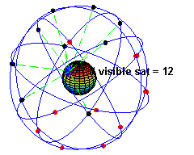
The GPS Angler:
United States – GNSS
32 Orbiting – 28 Useable
European Union – GALILEO
30 Planned – 2 Useable
Russia – GLONASS
24 Planned – 20 Useable
China – Compass
30 Planned – 5 Useable

Slide 3
The GPS Angler:
Humminbird GPS System has Evolved
GR-4: Was originally a 4 Channel Receiver – 3 Meter Accuracy
GR-4: Then upgraded to 12 Channel Receiver – 3 Meter Accuracy
GR-16: 16 Channel Receiver – 3 Meter Accuracy
Today all 300 Series – 1100 Series feature the GR-50 Receiver
GR-50: 50 Channel Receiver – 2.5 Meter Accuracy
All Internal or External Models Feature GR-50 Receiver

Slide 4
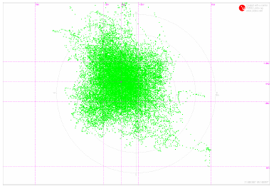
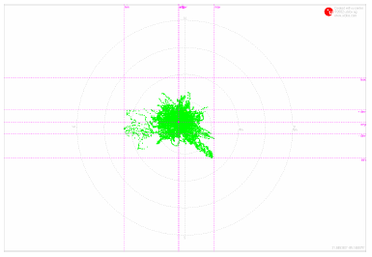
The GPS Angler:
24 HOUR POSITION PLOT
Humminbird GR-16 Humminbird GR-50

Slide 5
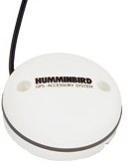
The GPS Angler:
Humminbird GR-50 Advantages
Higher Accuracy Level
Track More Satellites
Faster Acquisitions
4X per Second Refresh Rate
(Standard Equipment)

Slide 6
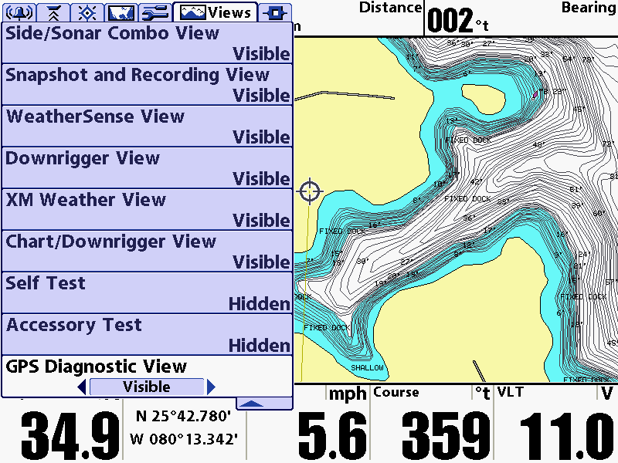
The GPS Angler:
How to Get
GPS Diagnostic View
Master Menu
(Hit Menu Twice)
Then Views

Slide 7
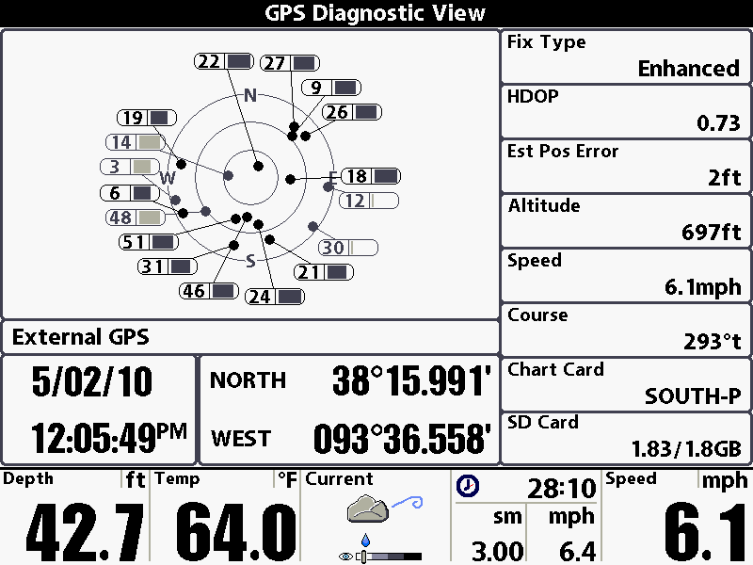
The GPS Angler:
B
A: Satellite Status
B: Fix Type
C: HDOP
D: Position Error
E: Altitude
F: Speed Over Ground
G: Heading
H/I: Card Readers
J: Location
K: Time and Date
L: GPS Type
M: Readouts Bar
A
C
D
E
F
L
G
H
K
J
I
M

Slide 8
The GPS Angler:
HDOP: Horizontal Dilution of Precision
1: Ideal - This is the highest possible confidence level to be used for applications demanding the highest possible precision at all times.
1-2: Excellent - At this confidence level, positional measurements are considered accurate enough to meet all but the most sensitive applications.
2-5: Good - Represents a level that marks the minimum appropriate for making business decisions. Positional measurements could be used to make reliable in-route navigation suggestions to the user.
5-10: Moderate - Positional measurements could be used for calculations, but the fix quality could still be improved. A more open view of the sky is recommended.
10-20: Fair - Represents a low confidence level. Positional measurements should be discarded or used only to indicate a very rough estimate of the current location.
>20: Poor - At this level, measurements are inaccurate by as much as 300 meters with a 6 meter accurate device (50 DOP × 6 meters) and should be discarded.

Slide 9
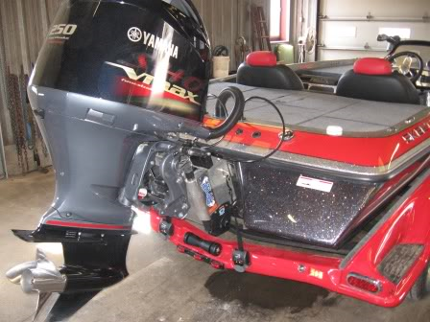
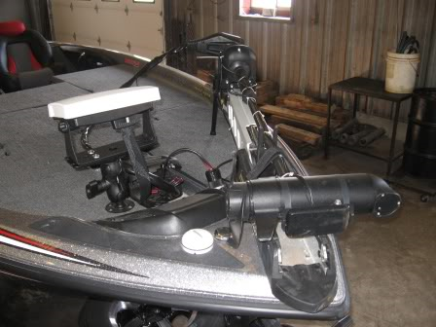
The GPS Angler:
Where to Mount Receiver

Slide 10
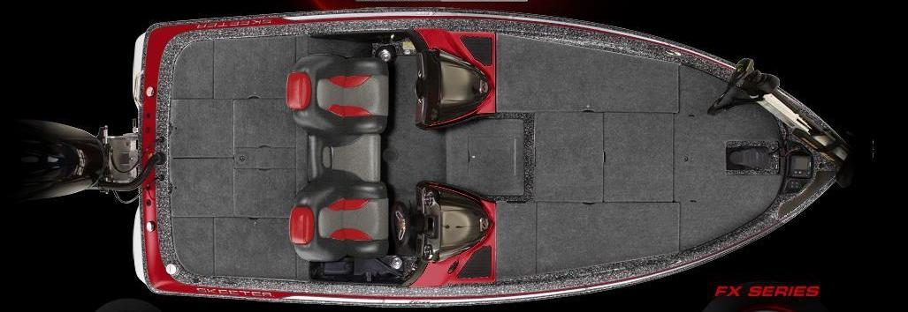
The GPS Angler:
Why?

Slide 11
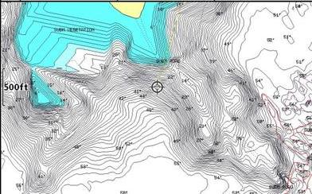
The GPS Angler:
Why Location Matters

Slide 12
The GPS Angler:
Why Location Matters

Slide 13
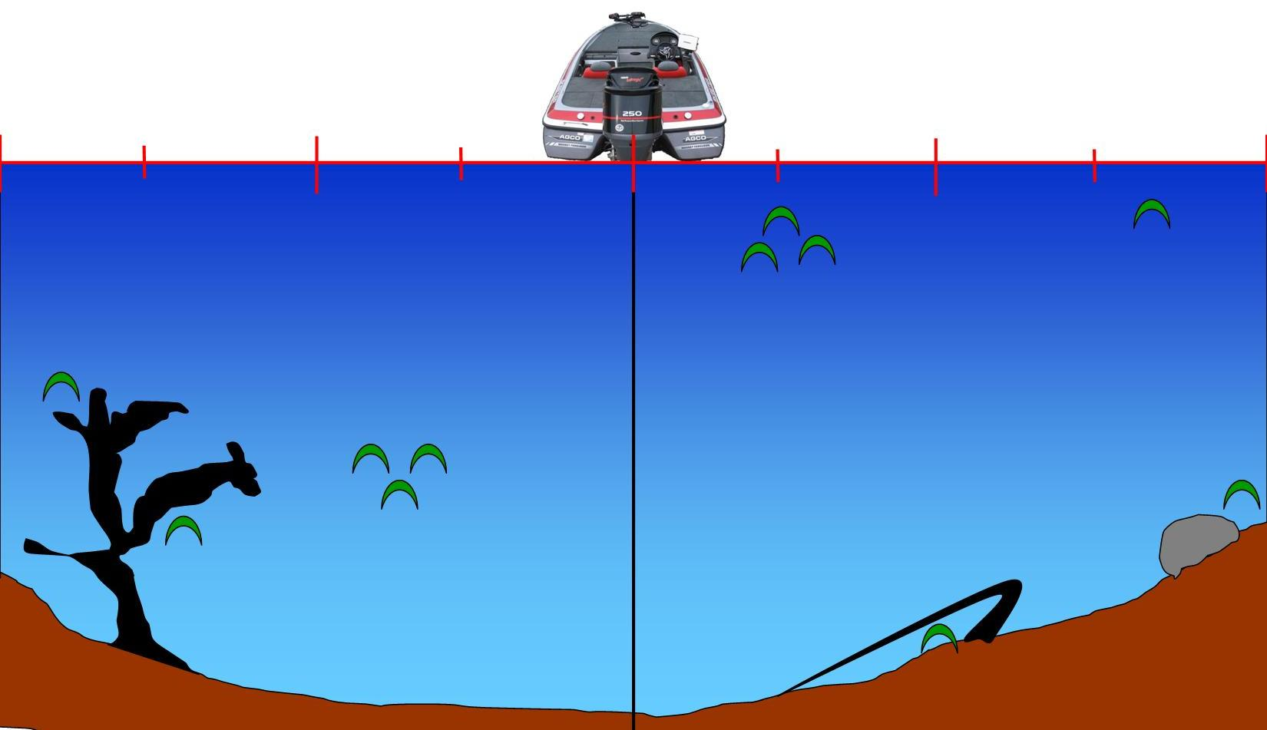
The GPS Angler:
Calculates Distance from Receiver

Slide 14
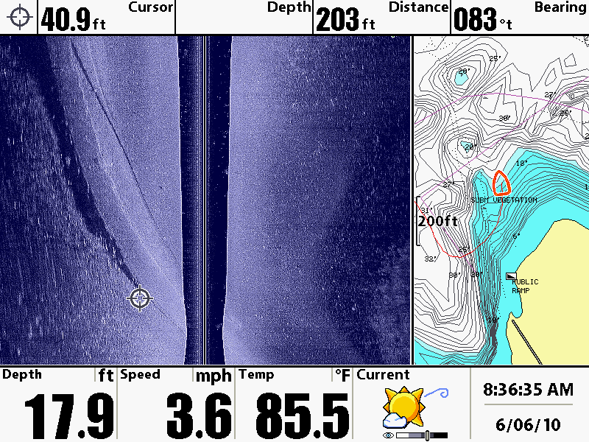
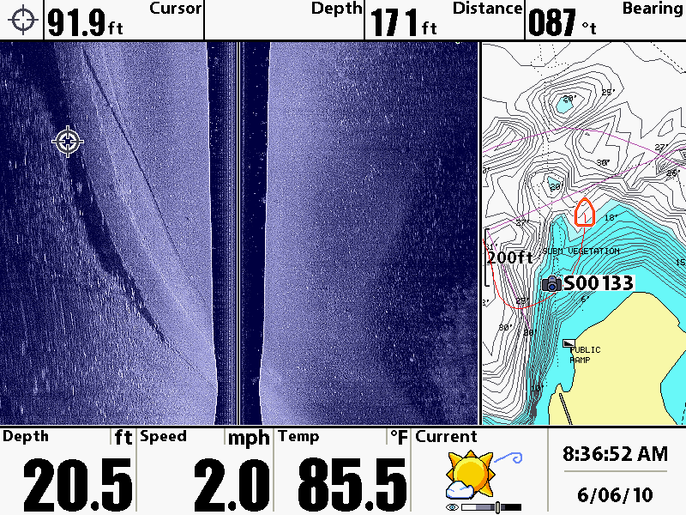
The GPS Angler:
Waypoints Mark at Cursor not Boat Position

Slide 15
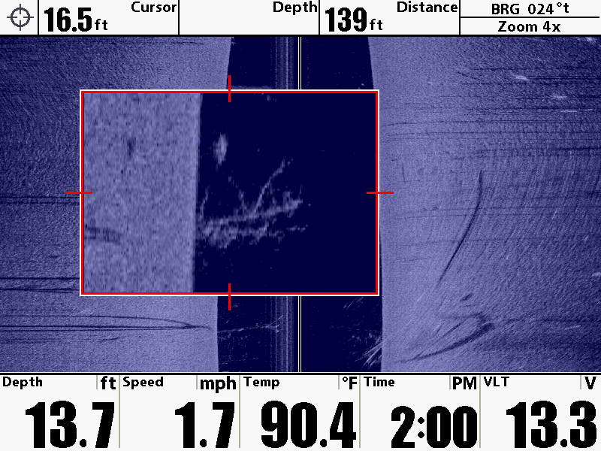
The GPS Angler:
ZOOM Box Waypoint Location

Slide 16
The GPS Angler:
Using Waypoints to Navigate

Slide 17
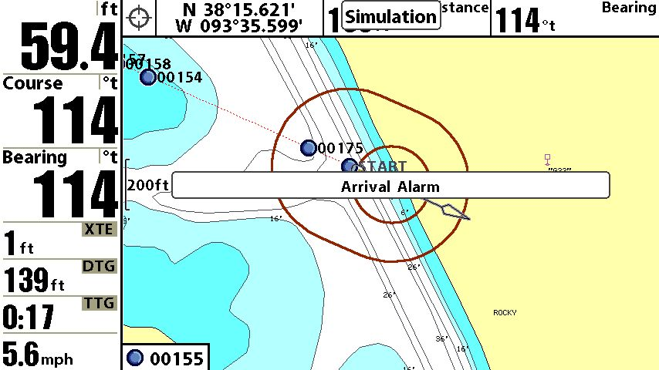
The GPS Angler:
Cross Track Error
Distance To Go
Time Track Error

Slide 18
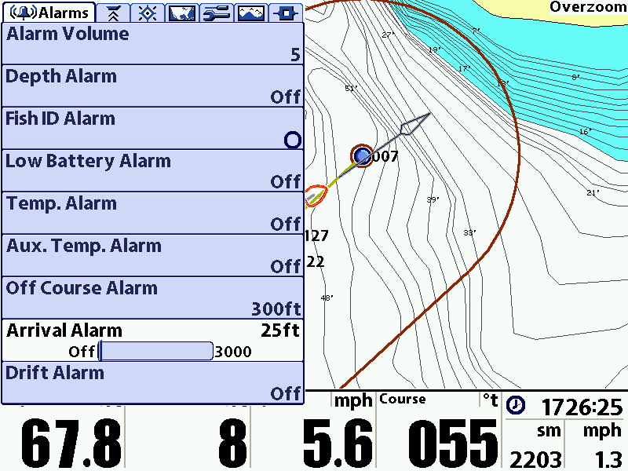
The GPS Angler:

Slide 19
Industry Leading Features as Standard Equipment
50 Channel GPS Receiver
4 Times Per Second Refresh Rate
High Accuracy
Innovative Waypoint Creation Feature
Humminbird GPS Gets you back on the Spot!

Slide 20


The GPS Angler:
GPS Technology enters the Trolling Motor Industry

Slide 21
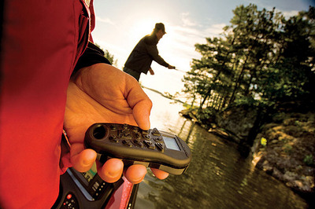
The GPS Angler:
Changed Boat Control
Cruise Control
Co-Pilot
Advanced Auto-Pilot
Record A Track
Spot Lock

Slide 22
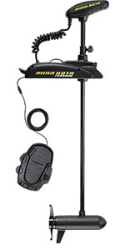
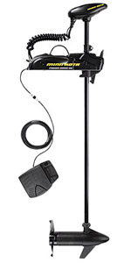
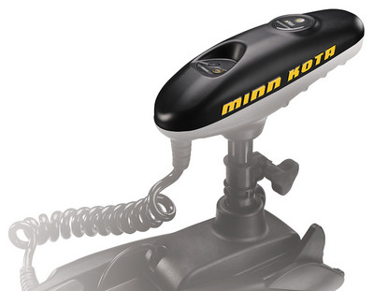
The GPS Angler:
iPilot Control for Terrova and Power Drive V2

Slide 23

iPilot Easy Installation

Slide 24
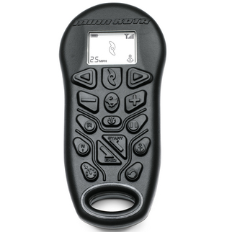
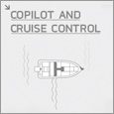
The GPS Angler:
Co-Pilot & Cruise Control
Allows you select Speed to 1/10th MPH
Control Steering
Turn Prop On/Off
High By-Pass

Slide 25
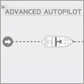
The GPS Angler:
Advanced Auto-Pilot
You select heading and the iPilot will control steering
iPilot will compensate for Wind, Waves, Current or Drift

Slide 26
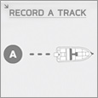
The GPS Angler:
Record A Track
You record a track you want to fish.
iPilot will retrace that track.
Save 3 Tracks in Memory
Max 2 Miles Long

Slide 27
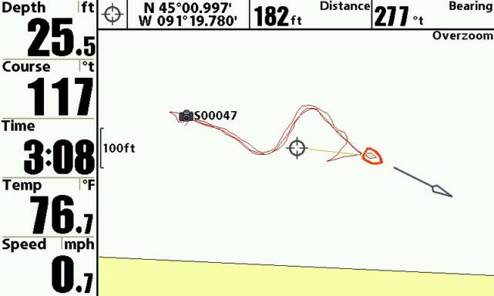
The GPS Angler:
Record A Track Proof

Slide 28
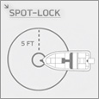
The GPS Angler:
Spot Lock
Electronic Anchor
5’ Drift from Spot – iPilot with engage to return to original spot
Save 3 Spots in Memory
Can activate ¼ mile from spot.

Slide 29
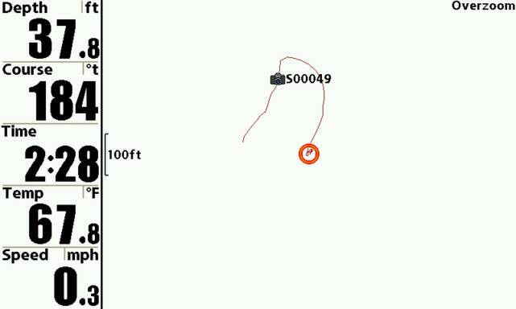
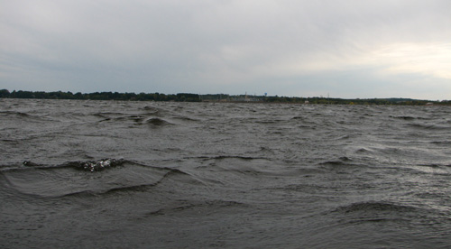
The GPS Angler:
Spot Lock Proof

Slide 30

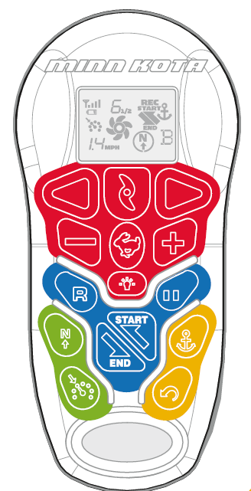







The GPS Angler:

Slide 31




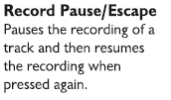



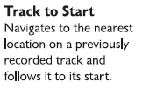
The GPS Angler:

Slide 32



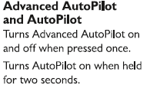


The GPS Angler:

Slide 33






The GPS Angler:

Slide 34
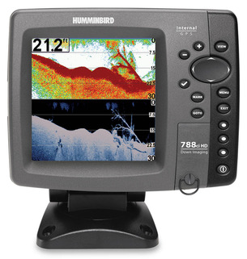
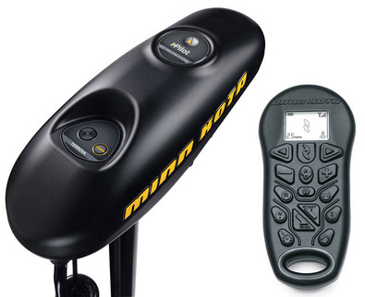
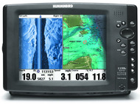
The GPS Angler:

Slide 35


The GPS Angler:
GPS Gets you back on the Spot!
GPS Keeps you on the Spot!
Is the Purchase Spot!

Slide 36
The GPS Angler:
Thank You
Doug Vahrenberg
MinnKota – Humminbird Pro-Team

