Slide 1

Using Humminbird Sonar Systems to Identify & Catch More Fish
Advanced Sonar
Doug Vahrenberg
Humminbird Pro-Team

Slide 2
The 3 Sonars
Advanced Sonar

Slide 3
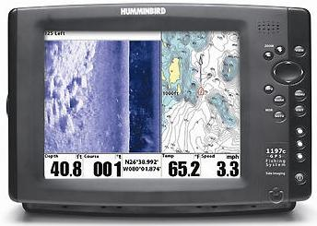
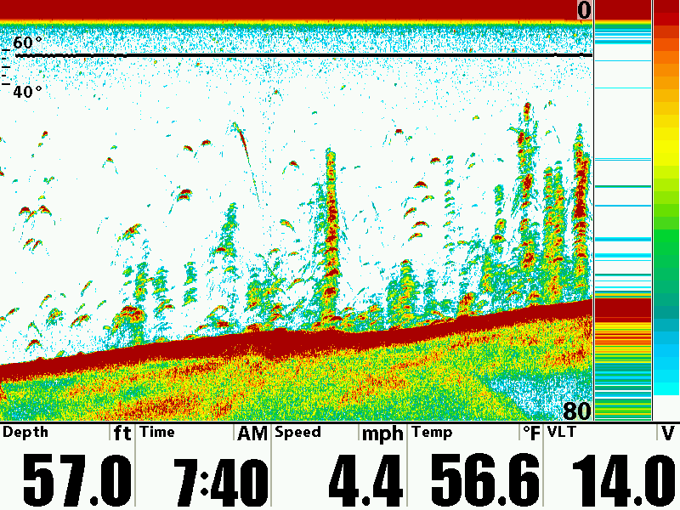
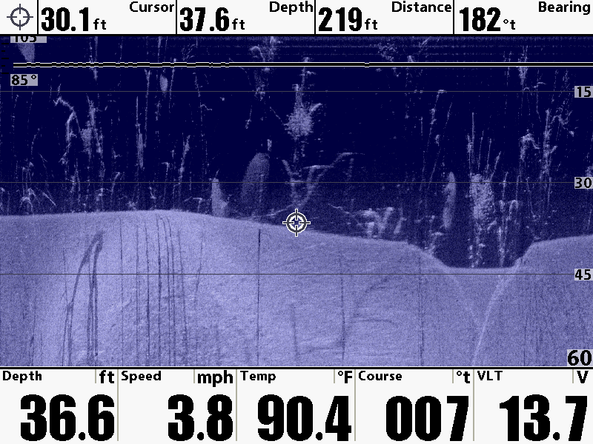
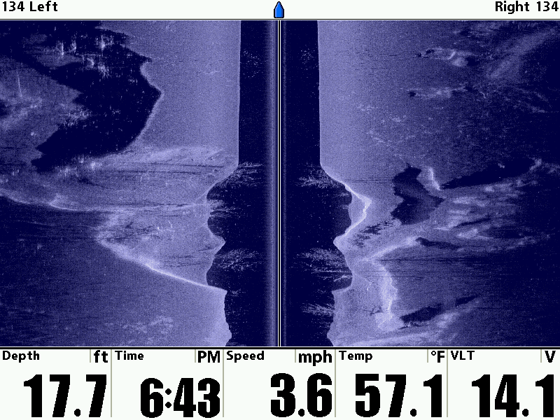
Advanced Sonar
Side Imaging Sonar
Down Imaging Sonar
Switchfire 2D Sonar

Slide 4
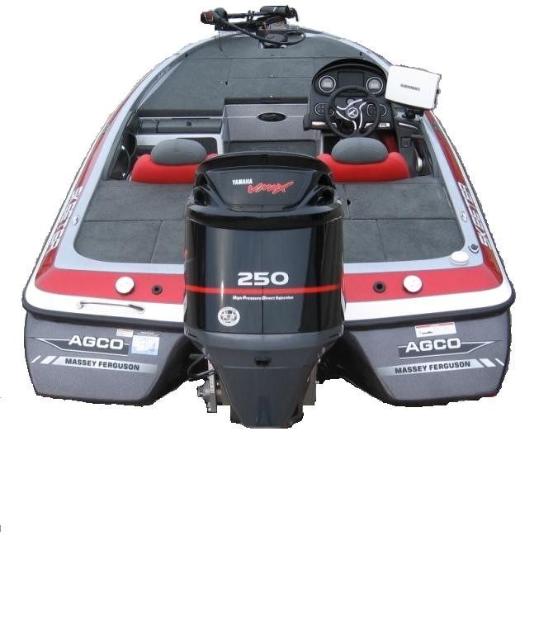
Humminbird Switchfire Sonar
Dual Beam Plus Sonar
Advanced Sonar
200 kHz = 20 Degrees
1/3 of Depth Coverage
83 kHz = 60 Degrees
Equal Coverage

Slide 5
Humminbird Down Imaging Sonar
Advanced Sonar
Wide: 1.5 X Depth Coverage
Medium: Equal to Depth Coverage
Narrow: 1/3 of Depth Coverage
Down Imaging
REAR VIEW

Slide 6
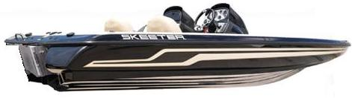
Humminbird Down Imaging Sonar
Advanced Sonar
Down Imaging
SIDE VIEW

Slide 7
Humminbird Side Imaging Sonar
Advanced Sonar
Side Imaging
REAR VIEW
Area of Coverage:
User Defined

Slide 8
Humminbird Down Imaging Sonar
Advanced Sonar
Side Imaging
SIDE VIEW

Slide 9
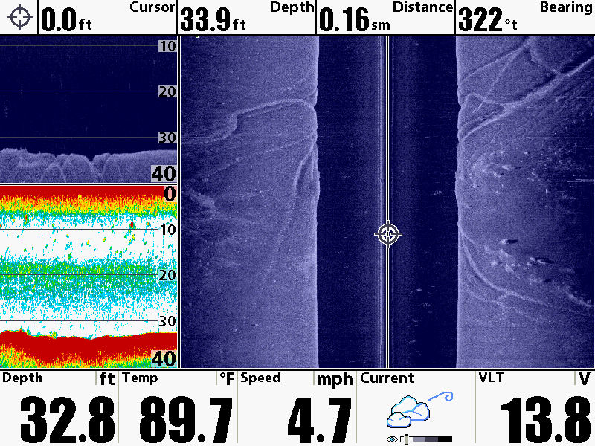
Advanced Sonar
Superior Details

Slide 10
How to Find Fish
Advanced Sonar
Scan areas where fish live
Understand Seasonal Patterns
Sometimes they are closer than
you think…Scan Multiple Passes
Use Humminbird Advanced Features
Humminbird Advanced Sonar

Slide 11
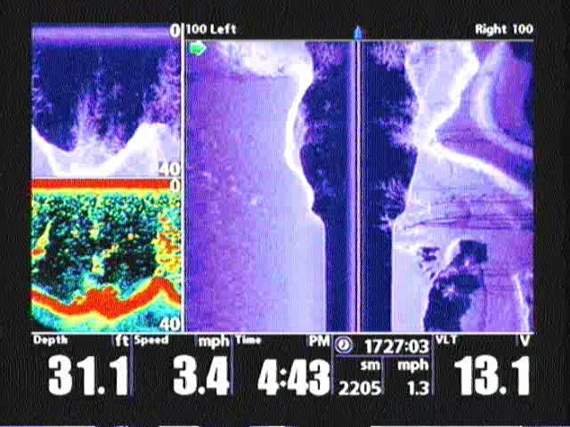
Advanced Sonar
Resolution lost in Video Conversion

Slide 12
Set-up is key…
Advanced Sonar
200/83 kHz Combo finds fish
200 kHz Only for High Speed
Switchfire Clear Mode < 10 Foot
Switchfire Max Mode > 10 Foot
Adjust Sensitivity to clear Clutter
Scroll Speed Match Boat Speed
Humminbird Switchfire 2D Sonar

Slide 13
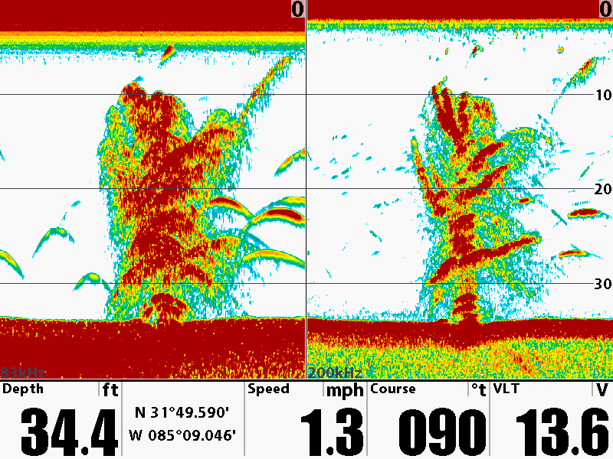
Dual Beam Plus
Dual Beam Plus Advantage

Slide 14
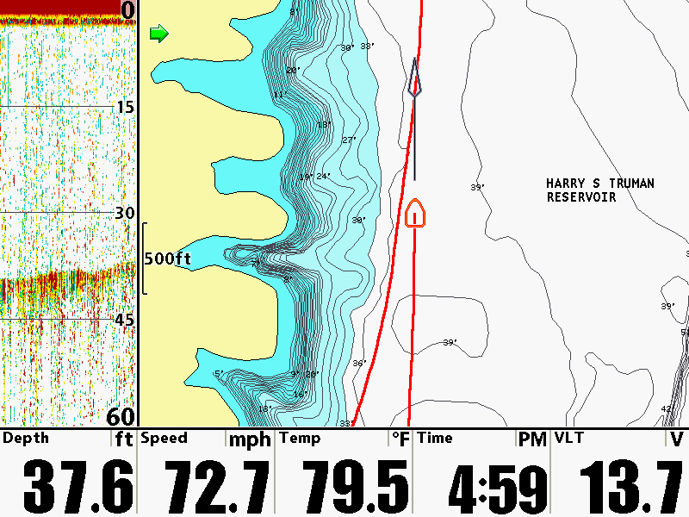
Dual Beam Plus
200kHz Holds at 70mph+

Slide 15
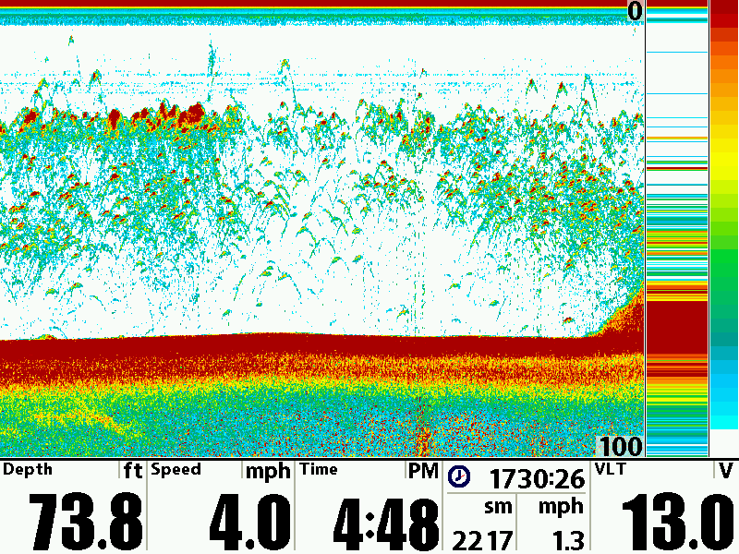
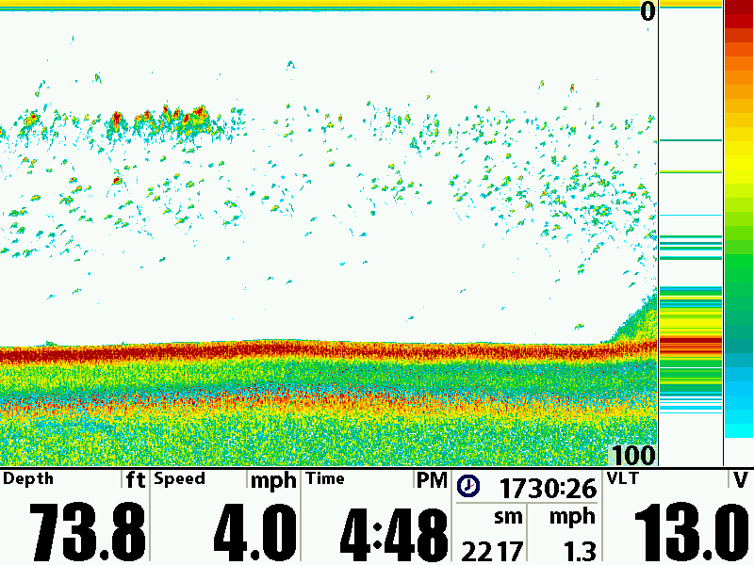
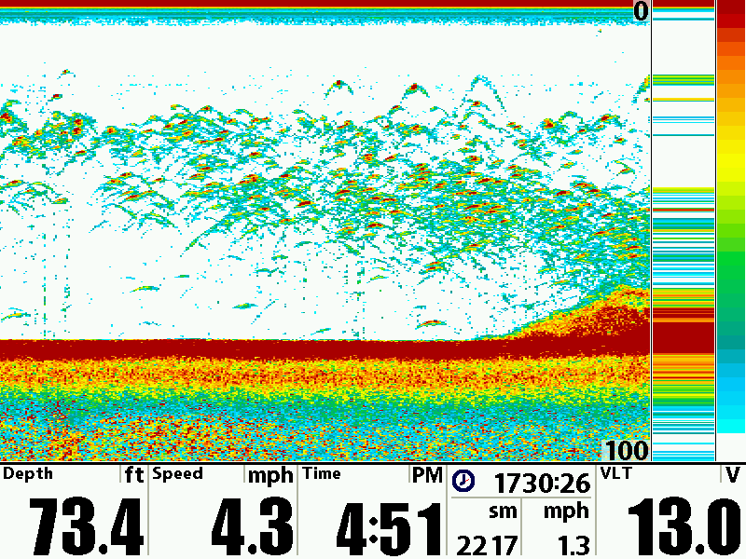
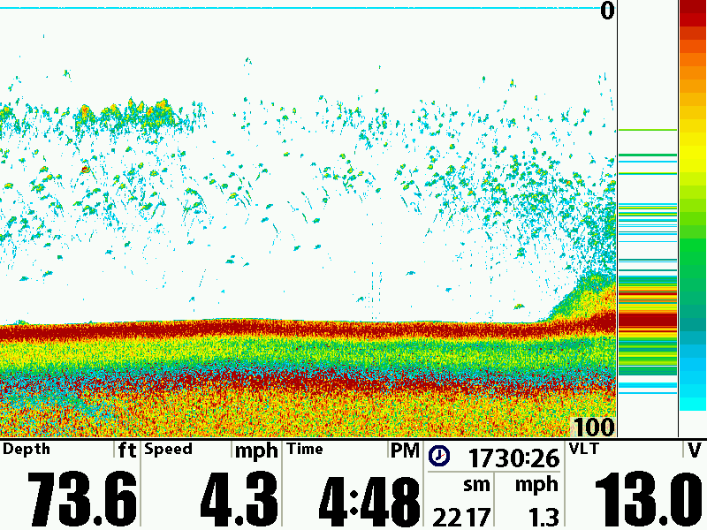
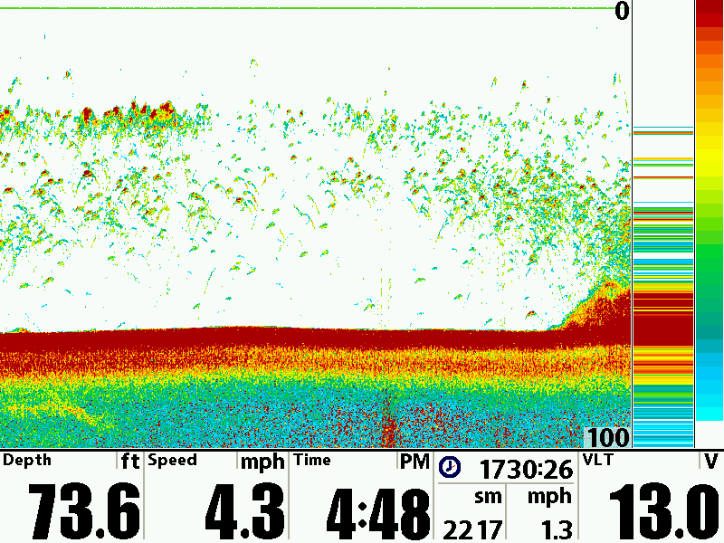
Switchfire 2D
Switchfire Max, Sensitivity 14, Speed 4
Switchfire Max, Sensitivity 5, Speed 4
SwitchfireMax,Sensitivity 15, Speed 10
SwitchfireClear, Sensitivity 10, Speed 4
SwitchfireClear, Sensitivity 18, Speed 4

Slide 16
Set-up is key…
Advanced Sonar
Chart Speed match Boat Speed
Increase Sensitivity +1 or +2
Changing Terrain – Set Max Depth
NEW – Down Imaging Zoom
Humminbird Down Imaging Sonar

Slide 17
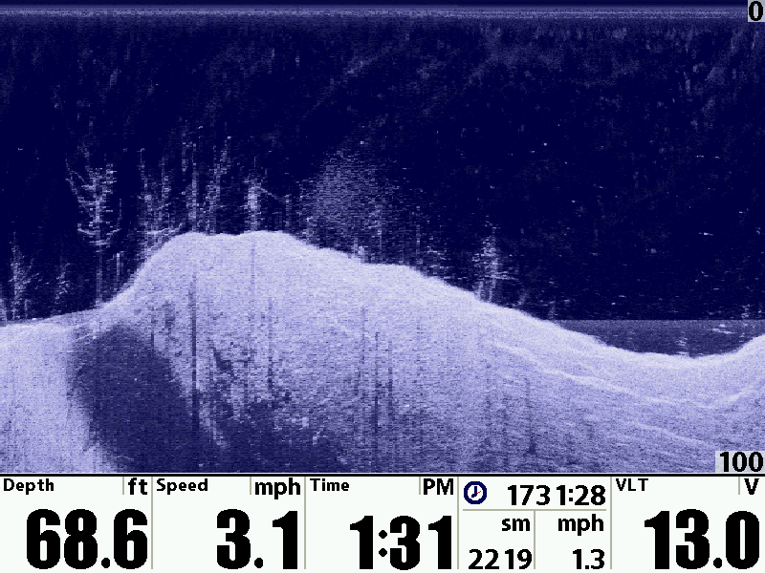
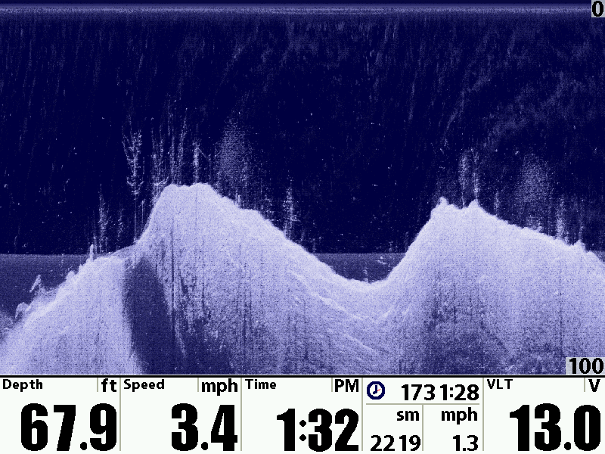
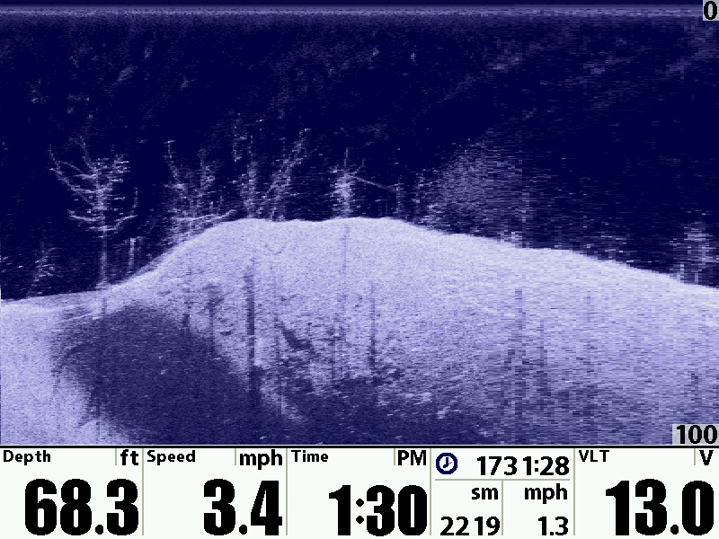
Down Imaging
Sensitivity 12 , Chart Speed 6
Sensitivity 12 , Chart Speed 3
Sensitivity 12 , Chart Speed 10

Slide 18
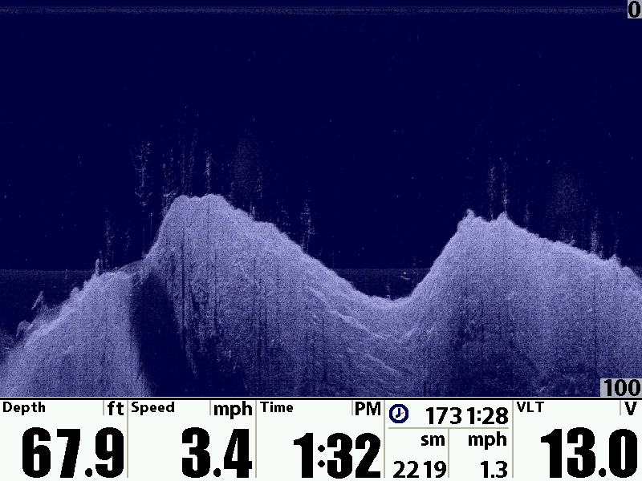
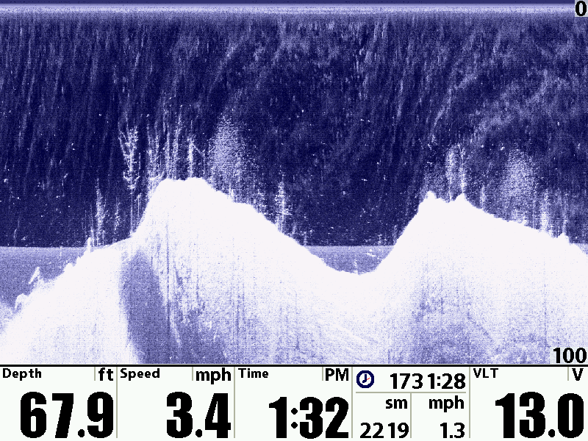
Down Imaging
Sensitivity 20 , Chart Speed 3
Sensitivity 12 , Chart Speed 3
Sensitivity 5 , Chart Speed 3

Slide 19
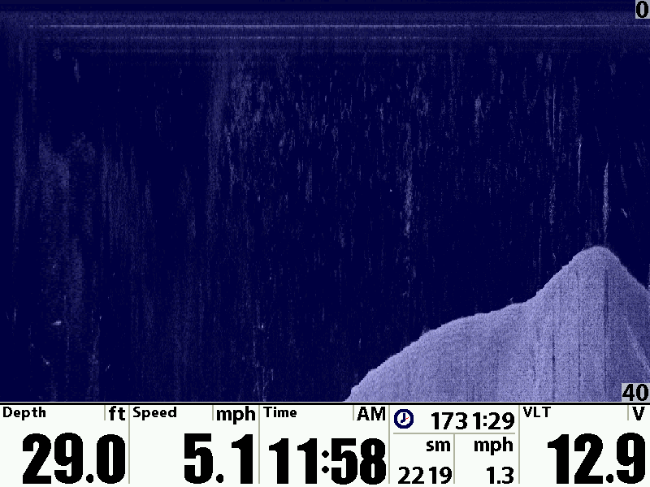
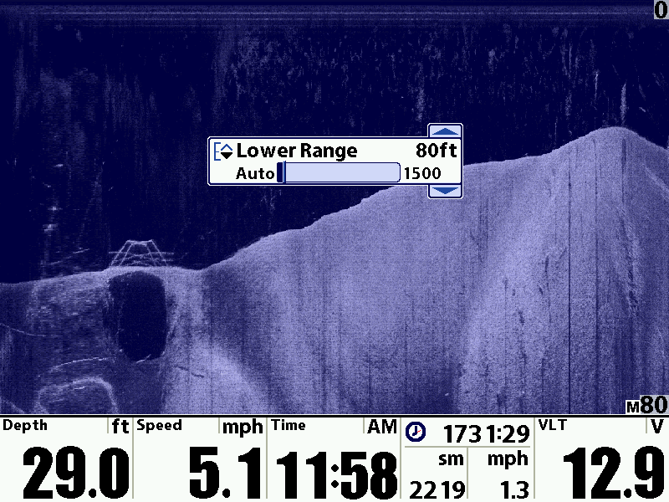
Down Imaging
Set Lower Range
Auto Range

Slide 20
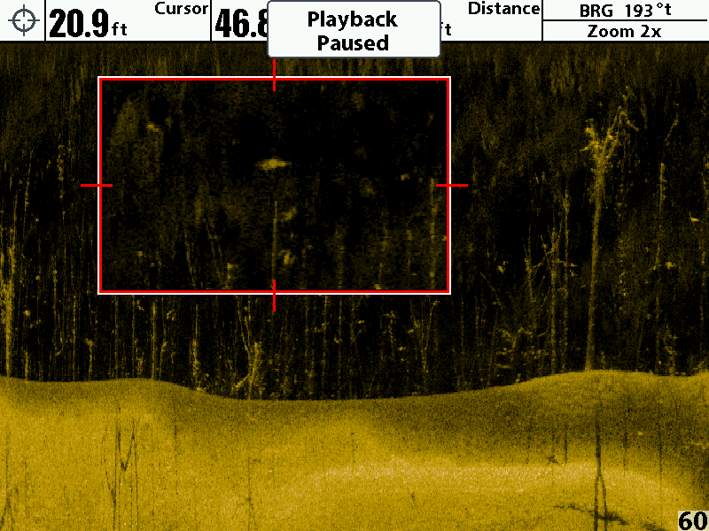
Down Imaging
NEW – Down Imaging Zoom

Slide 21
Set-up is key…
Advanced Sonar
Match Chart Speed to Boat Speed
Adjust Sensitivity to show details
Adjust Coverage Area
Slow Steady Straight Boat Speed
Choose Color Pallet best for you
Side Imaging Enhance
Humminbird Side Imaging Sonar

Slide 22
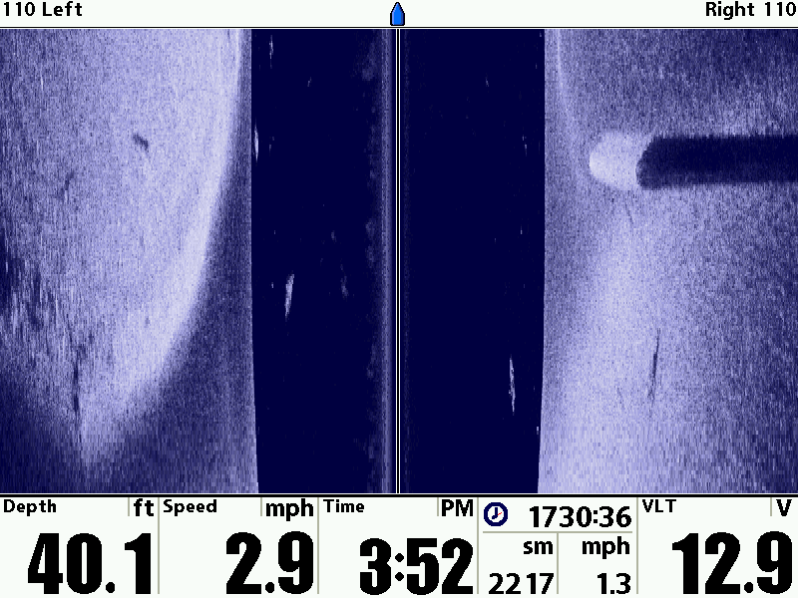
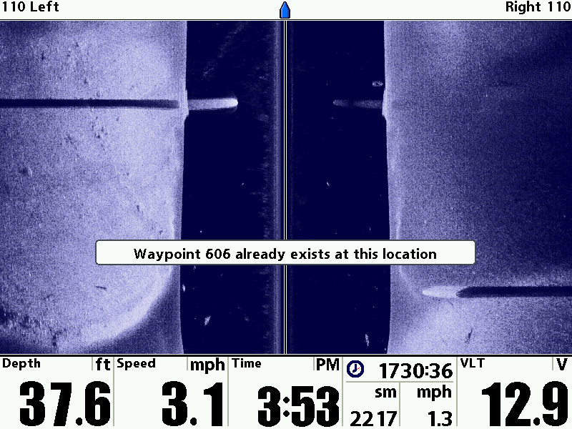
Side Imaging
Chart Speed 3
Chart Speed 10

Slide 23
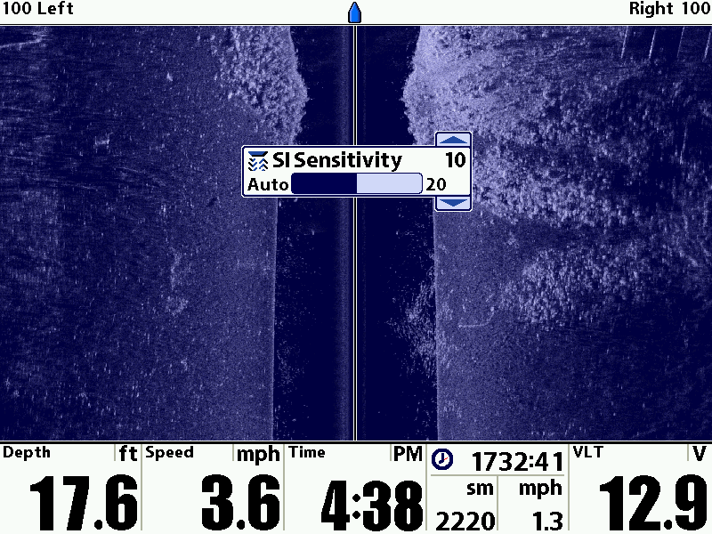
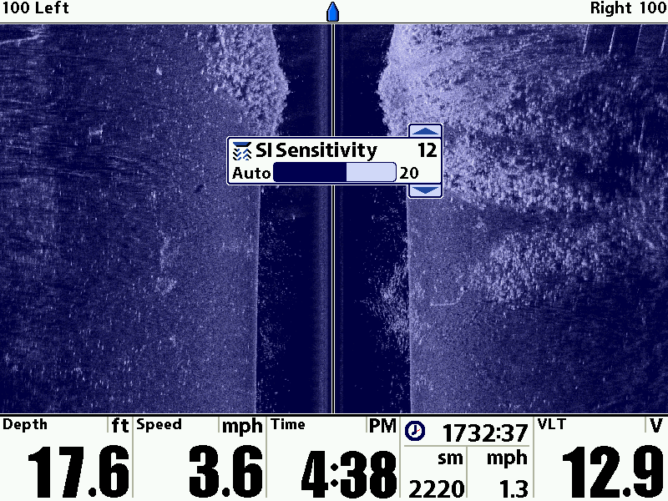
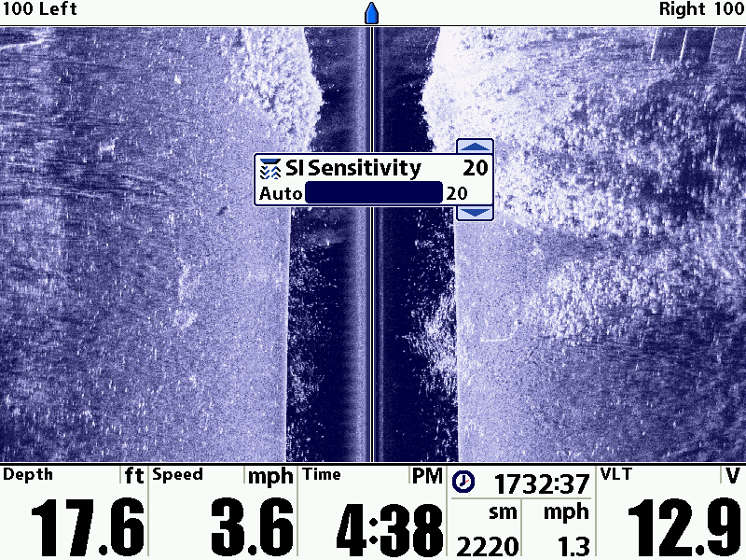
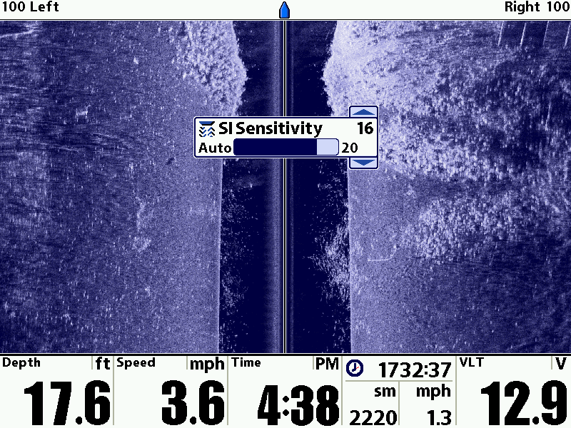
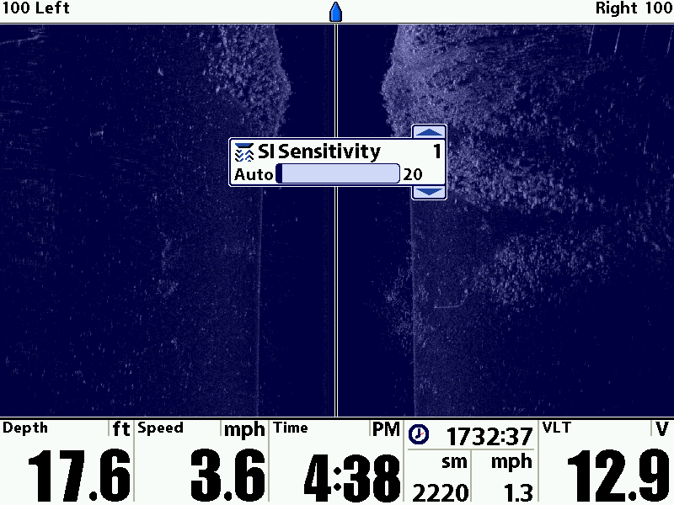
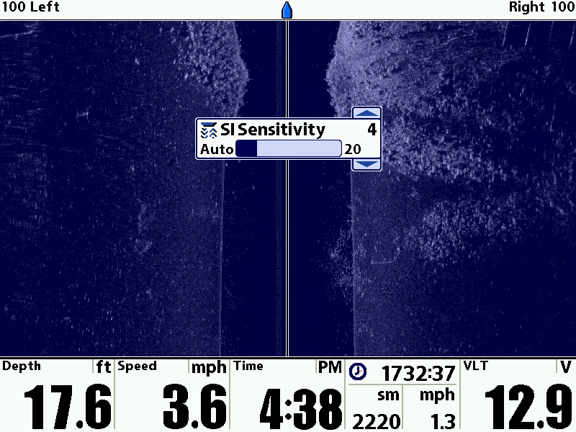
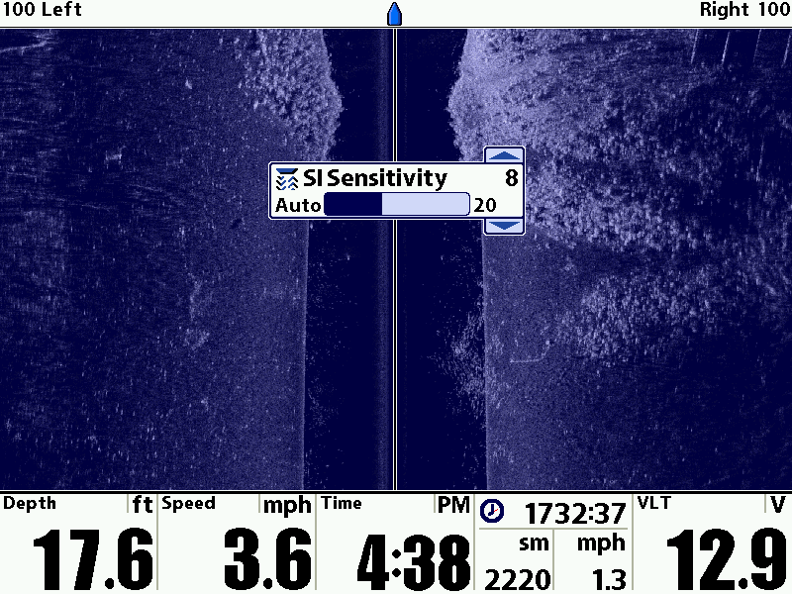
Side Imaging
Sensitivity Settings

Slide 24
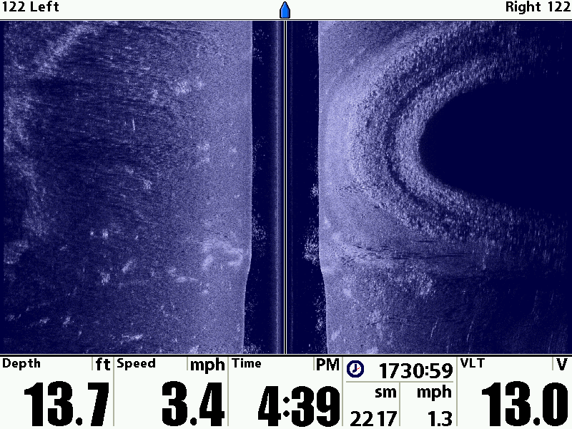
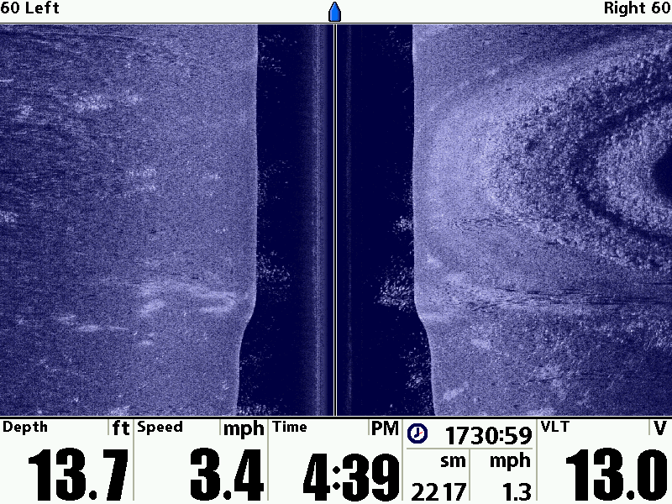
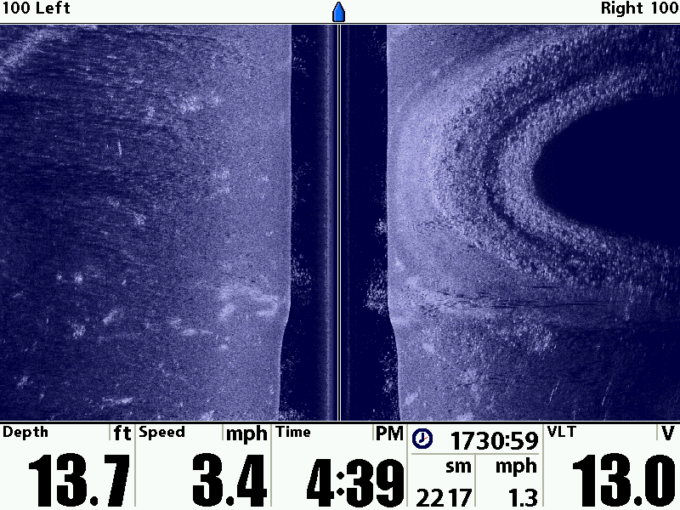
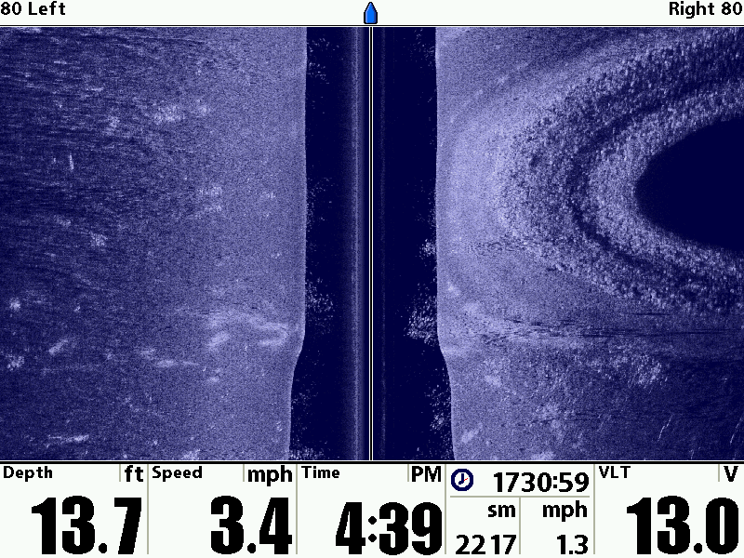
Side Imaging
Coverage Area 244’
Coverage Area 200’
Coverage Area 160’
Coverage Area 120’

Slide 25
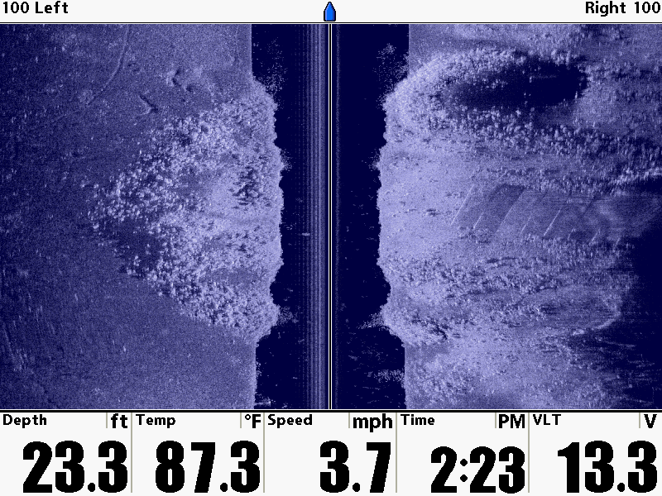
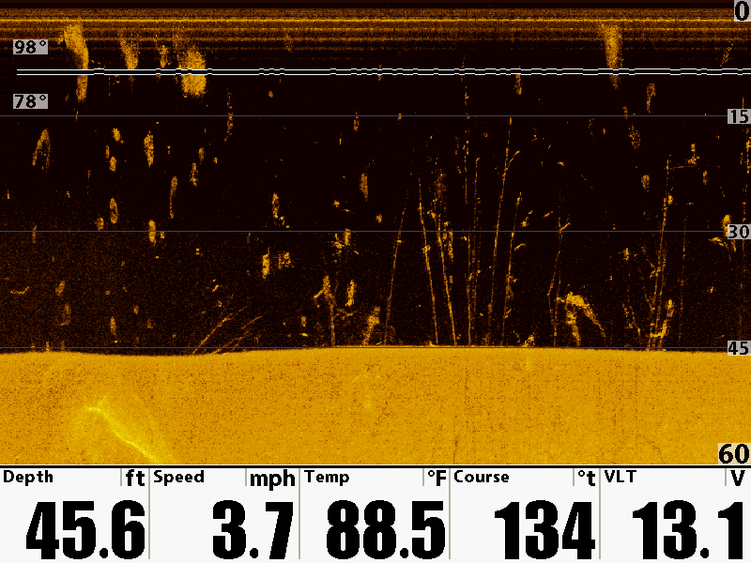
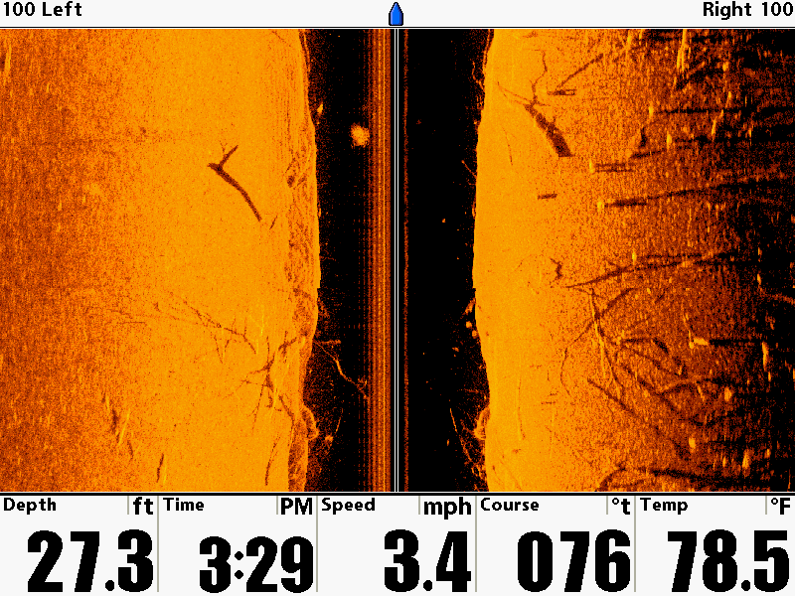
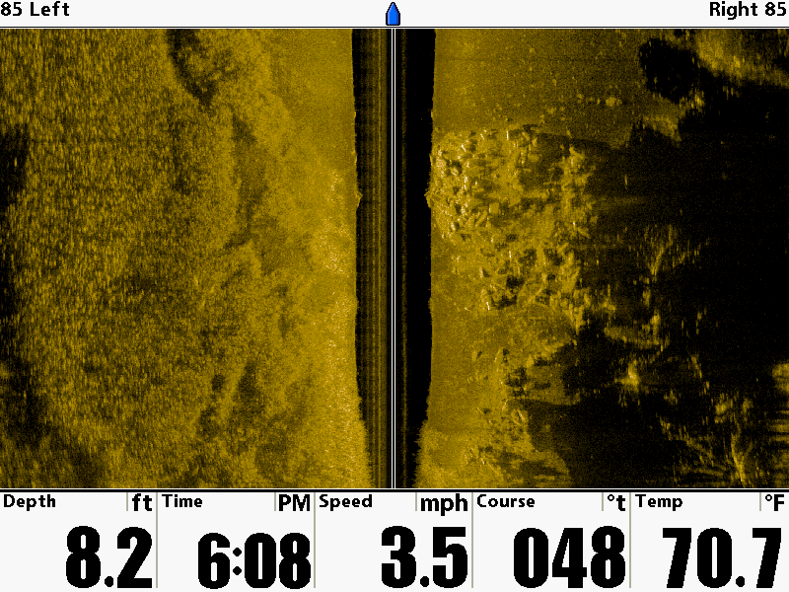
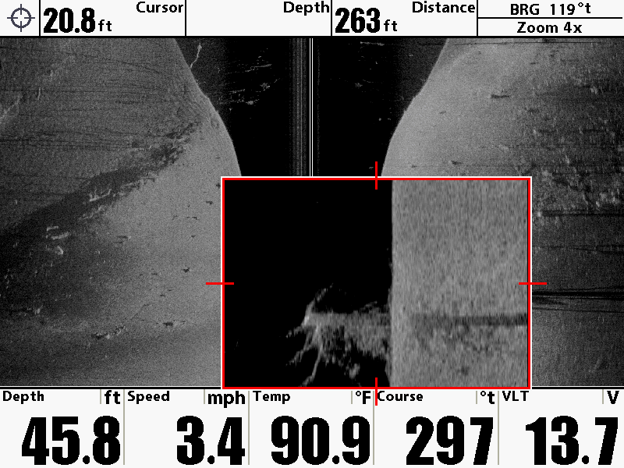
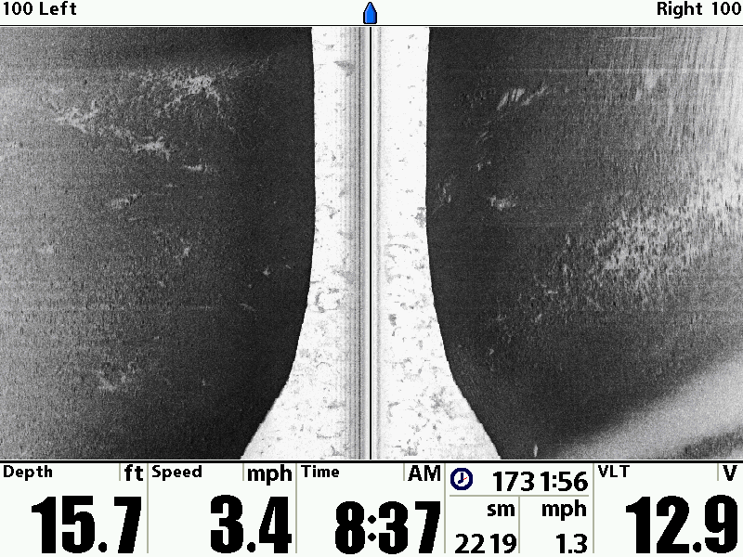
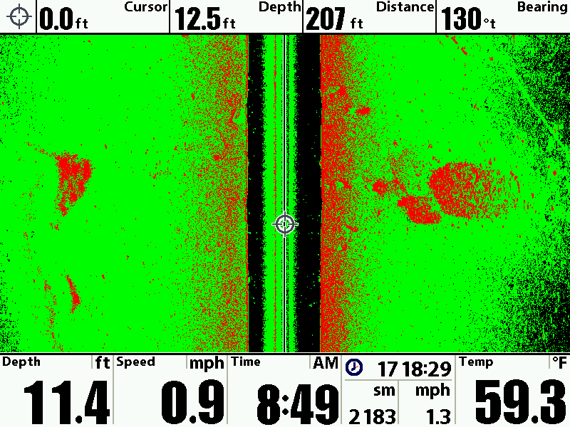
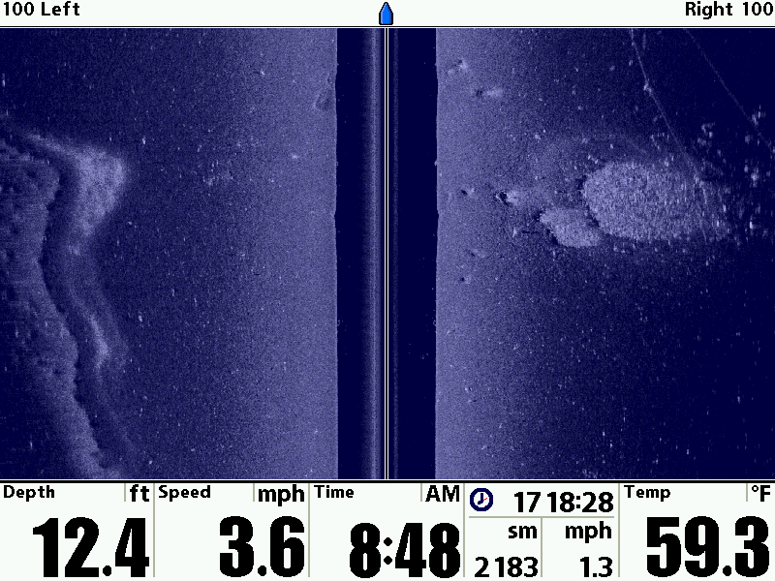
Side Imaging
SI/DI Color Pallets

Slide 26
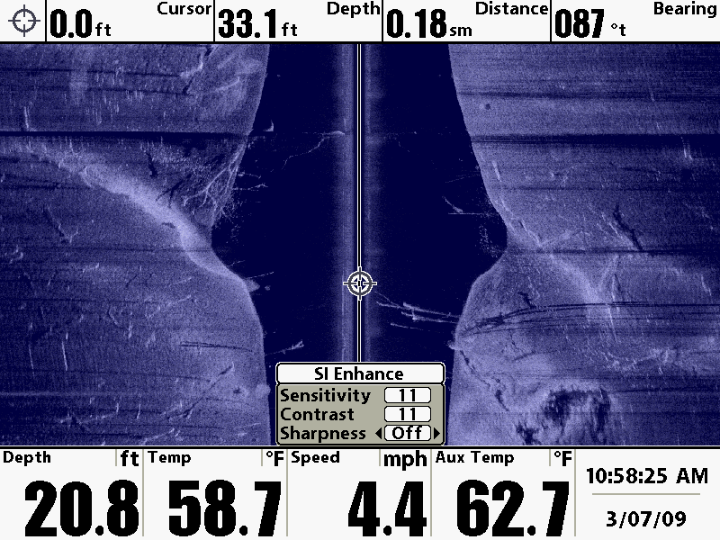
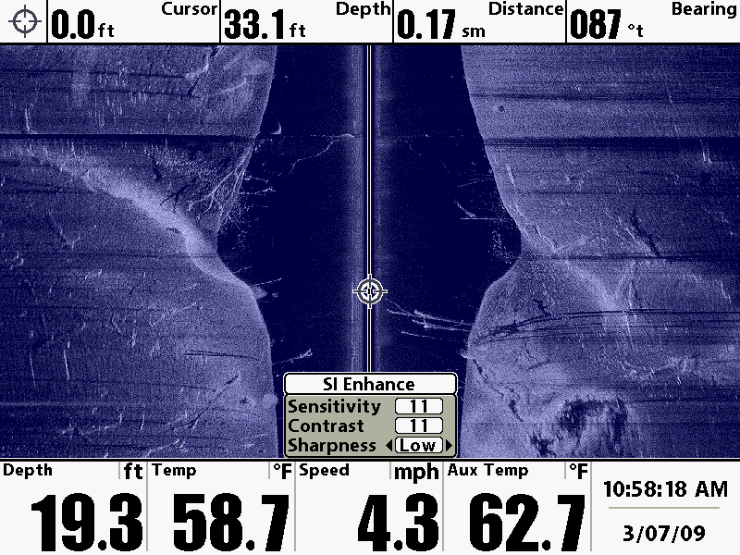
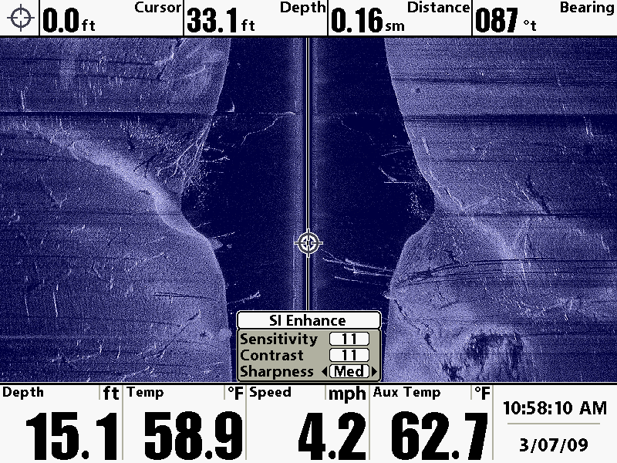
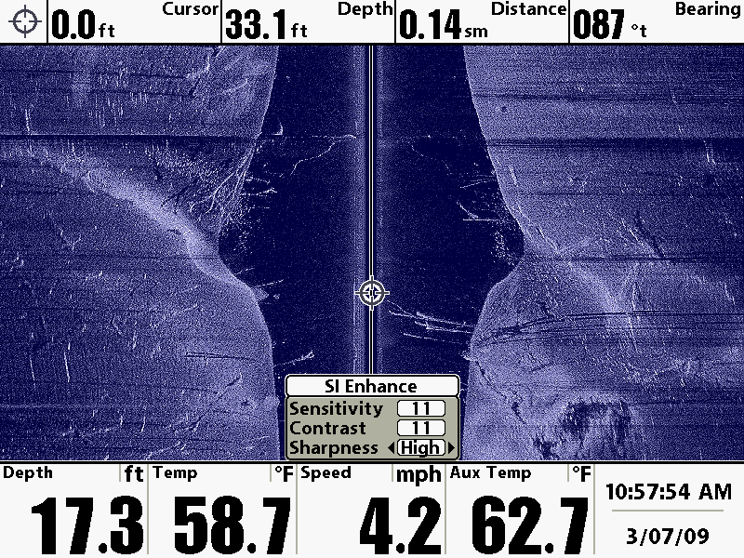
Side Imaging
Side Imaging Enhance

Slide 27
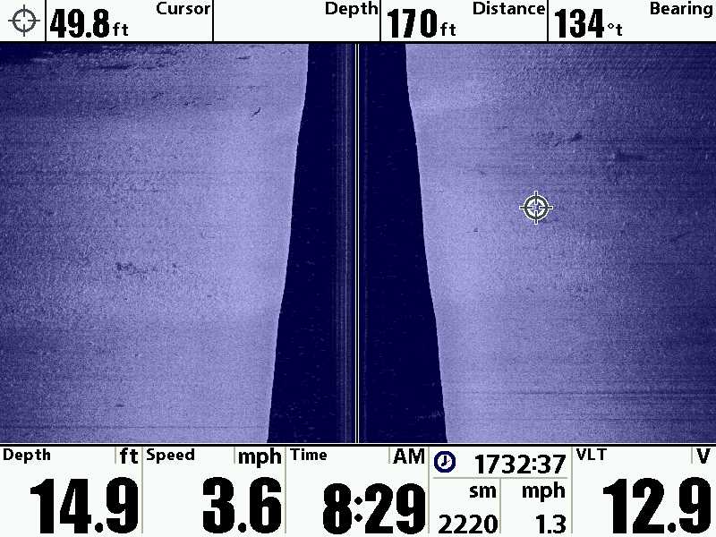
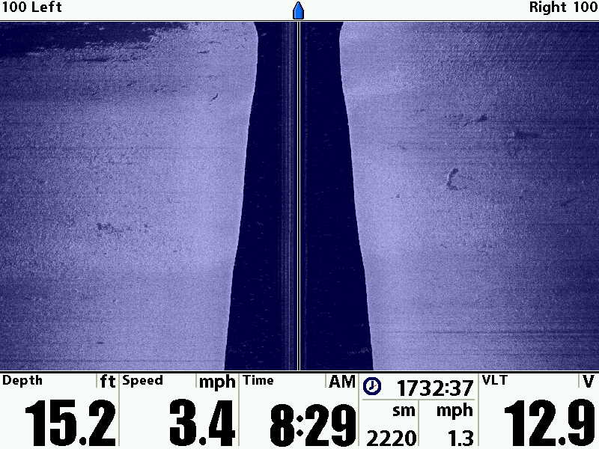
Side Imaging
Side Imaging Cursor

Slide 28



Side Imaging
Side Imaging Zoom

Slide 29


Side Imaging
NEW Features – Contour Mode

Slide 30


Side Imaging
NEW Features – SI Range Lines

Slide 31

Side Imaging
NEW Features – SI Navigation

Slide 32
Ready to
Catch Fish?
Advanced Sonar
Humminbird Advanced Sonar

Slide 33


Advanced Sonar
Find the Fish???

Slide 34

Advanced Sonar
Find the Crappie???

Slide 35

Advanced Sonar
Find the Fish???

Slide 36

Advanced Sonar
Find the Fish???

Slide 37
Advanced Sonar
Down Imaging Finds???

Slide 38

Advanced Sonar
Ledge Fish

Slide 39
Trolling Motor
Side Imaging
Advanced Sonar
Humminbird Side Imaging Sonar

Slide 40


Advanced Sonar
Humminbird Side Imaging Sonar

Slide 41



Advanced Sonar
Trolling Motor Side Imaging

Slide 42


Advanced Sonar
Trolling Motor Side Imaging Sonar

Slide 43
Sometimes
It’s Easy…
Advanced Sonar
Humminbird Side Imaging Sonar

Slide 44

Advanced Sonar
Way to Easy…

Slide 45

Advanced Sonar
Way to Easy…

Slide 46
Advanced Sonar
Way to Easy…

Slide 47
If you Believe
It will Reward
You!
Advanced Sonar
Humminbird Side Imaging Sonar

Slide 48


Advanced Sonar
The Week I started Believing…

Slide 49

Advanced Sonar
Thank You!
Doug Vahrenberg
Humminbird Pro-Team
Simply. Clearly. Better.

Slide 50
www.dougvahrenberg.com
Humminbird Forum www.bassboatcentral.com
Side Imaging Group http://groups.yahoo.com/group/sideimaging/
Advanced Sonar
Humminbird Side Imaging Sonar

