Slide 1

Catching Fish with Side Imaging
Doug Vahrenberg
Humminbird Pro-Team

Slide 2
Catching Fish with Side Imaging
What is Side Imaging
Side Imaging has brought a new dimension to fishing it has become the fisherman’s “Eyes” under the water surface

Slide 3
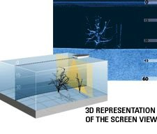
Catching Fish with Side Imaging

Slide 4
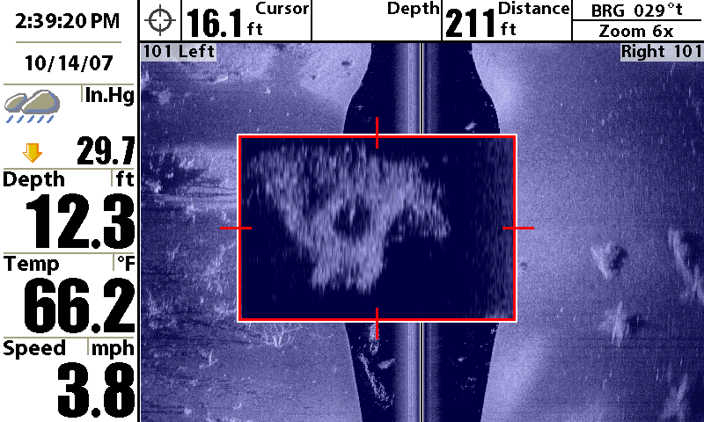
Catching Fish with Side Imaging

Slide 5
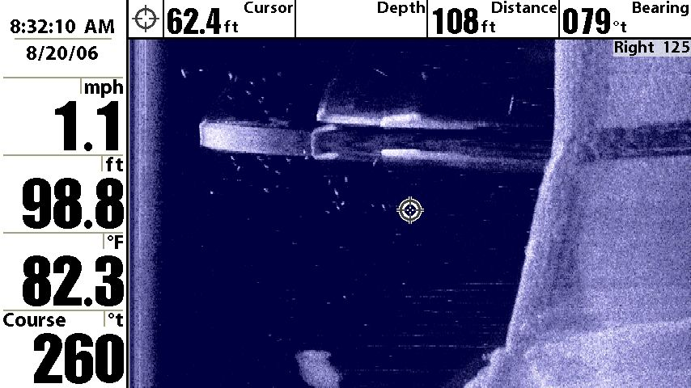
Catching Fish with Side Imaging

Slide 6
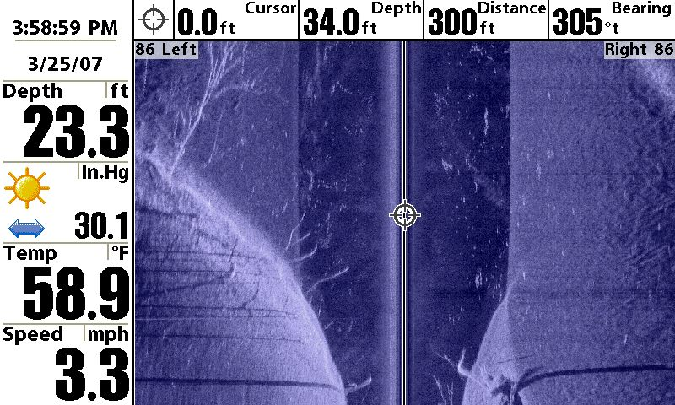
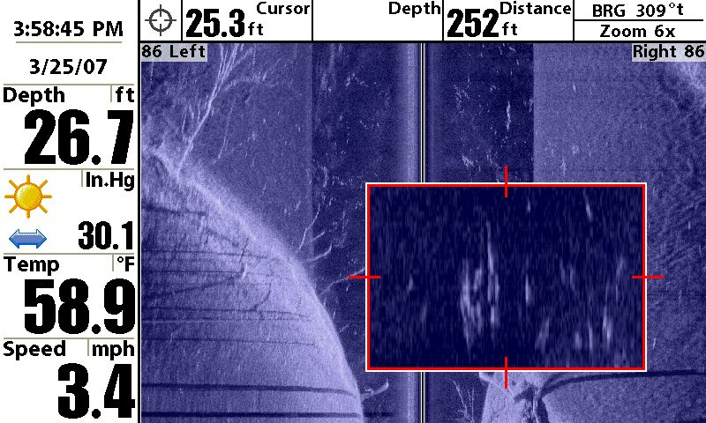
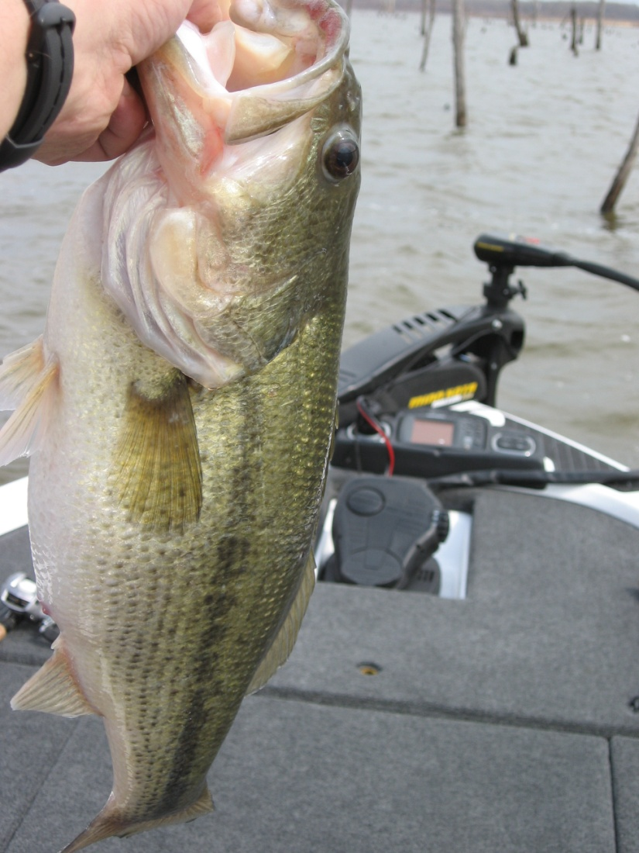
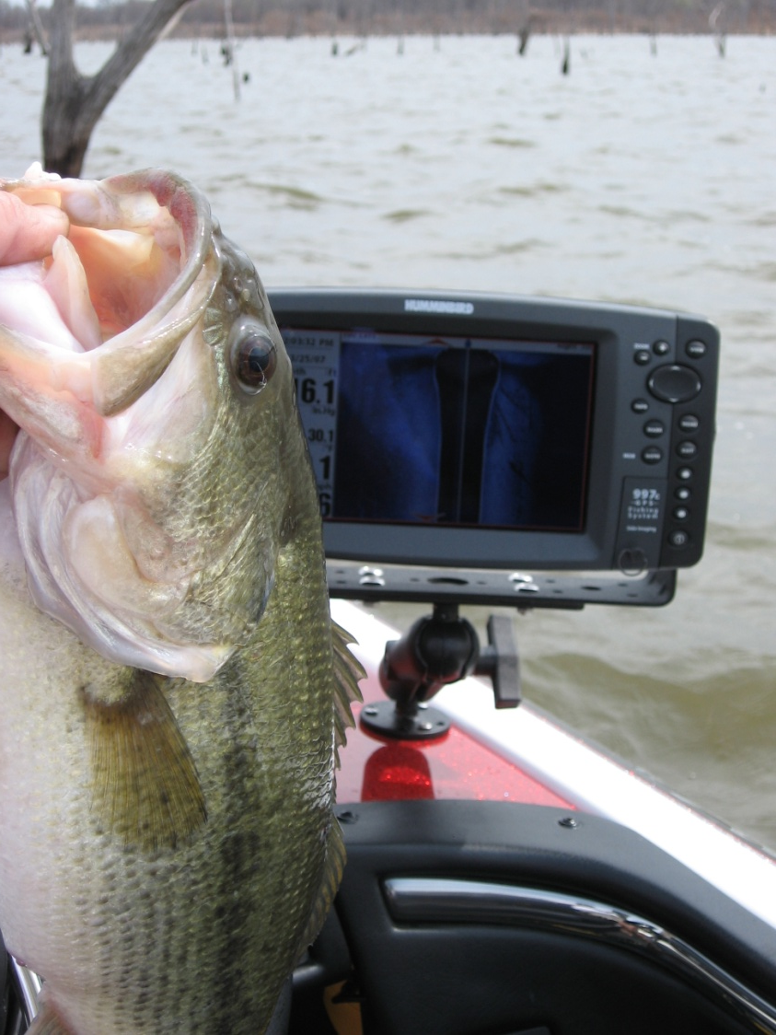
Catching Fish with Side Imaging

Slide 7
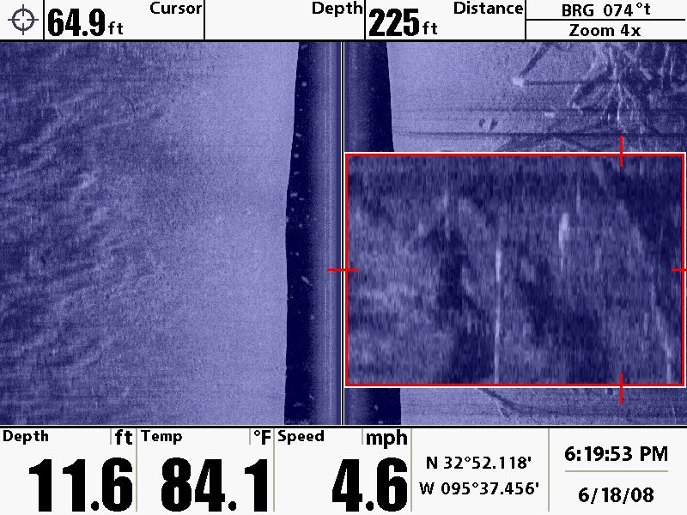
Catching Fish with Side Imaging

Slide 8
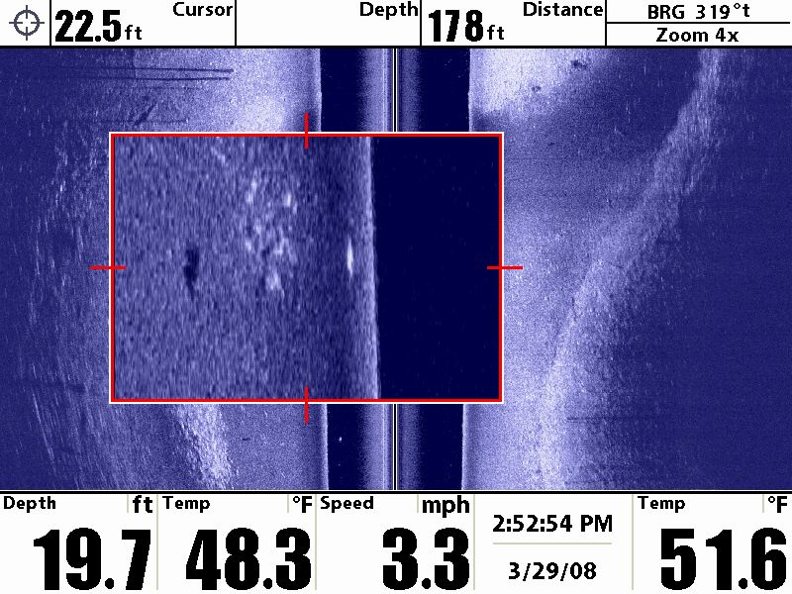
Catching Fish with Side Imaging

Slide 9
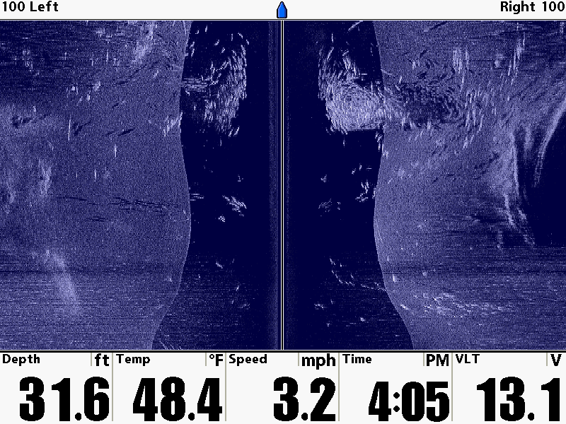
Catching Fish with Side Imaging

Slide 10
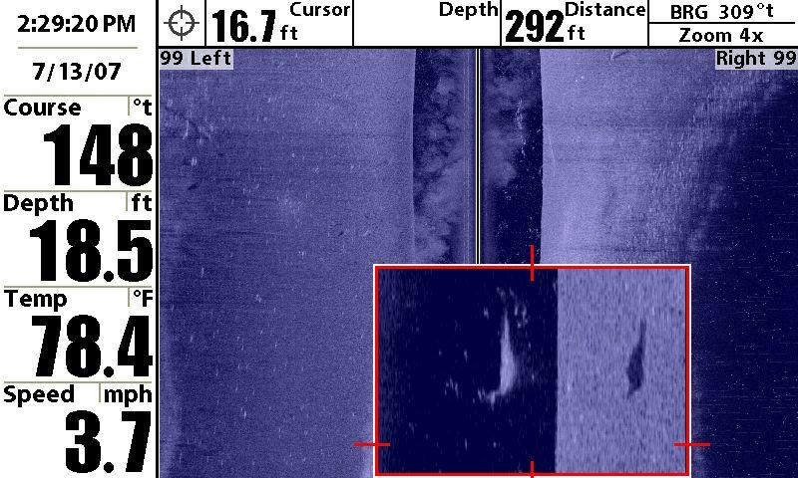
Catching Fish with Side Imaging

Slide 11
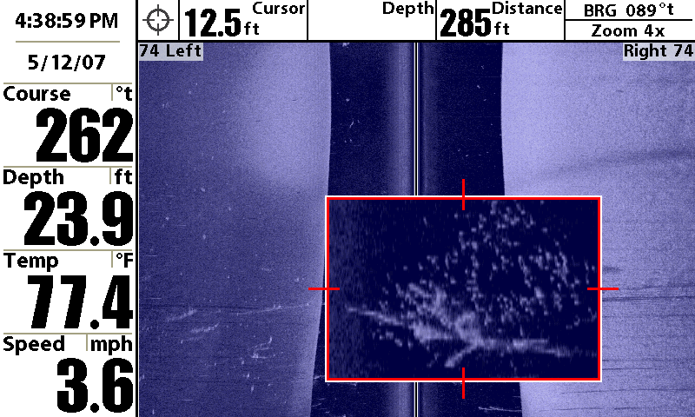
Catching Fish with Side Imaging

Slide 12
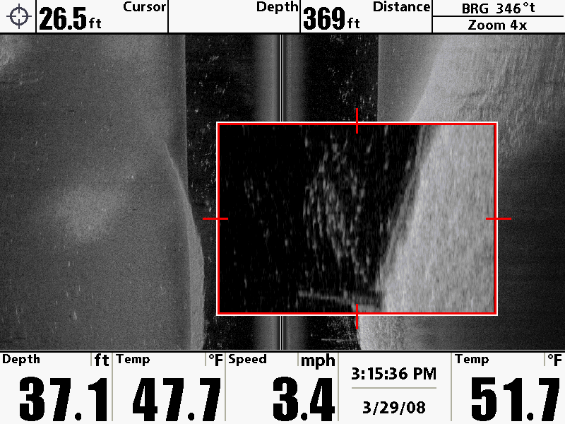
Catching Fish with Side Imaging

Slide 13
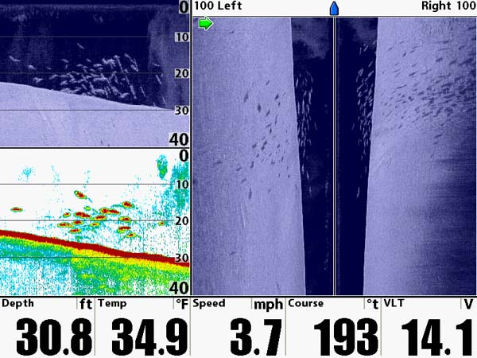
Catching Fish with Side Imaging

Slide 14
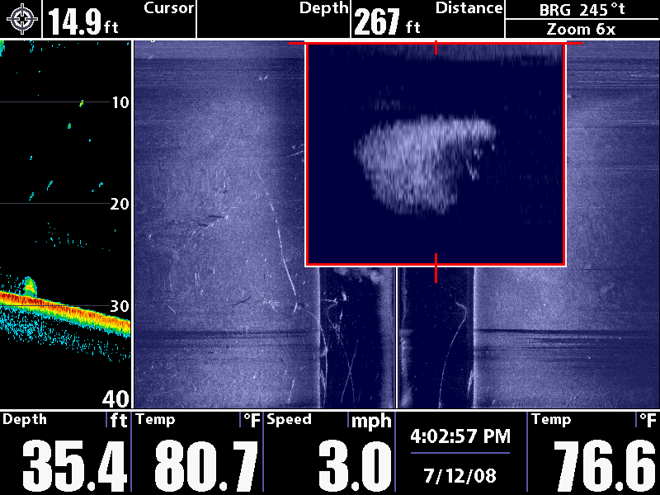
Catching Fish with Side Imaging

Slide 15
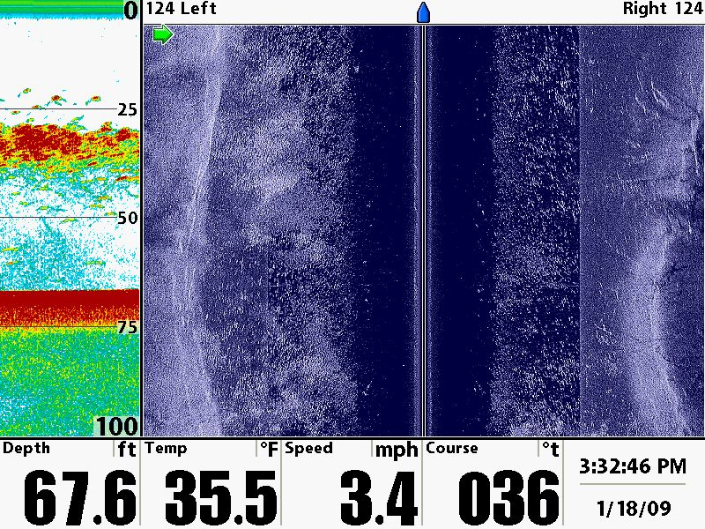
Catching Fish with Side Imaging

Slide 16
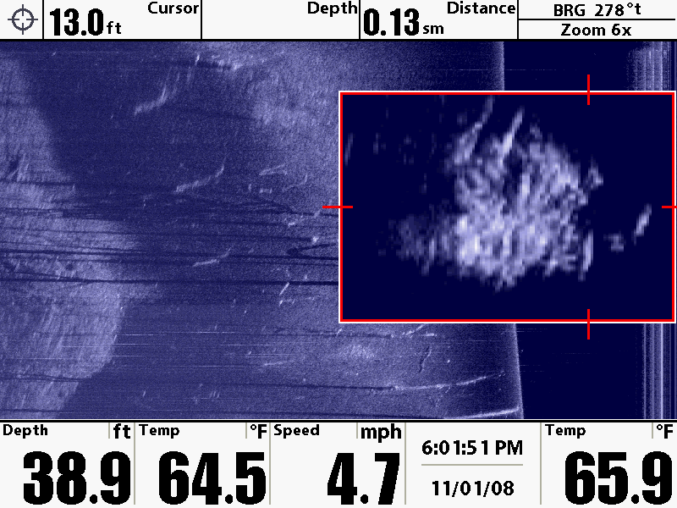
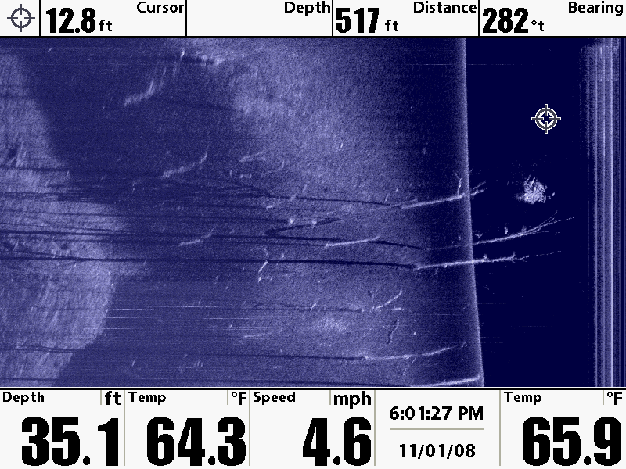
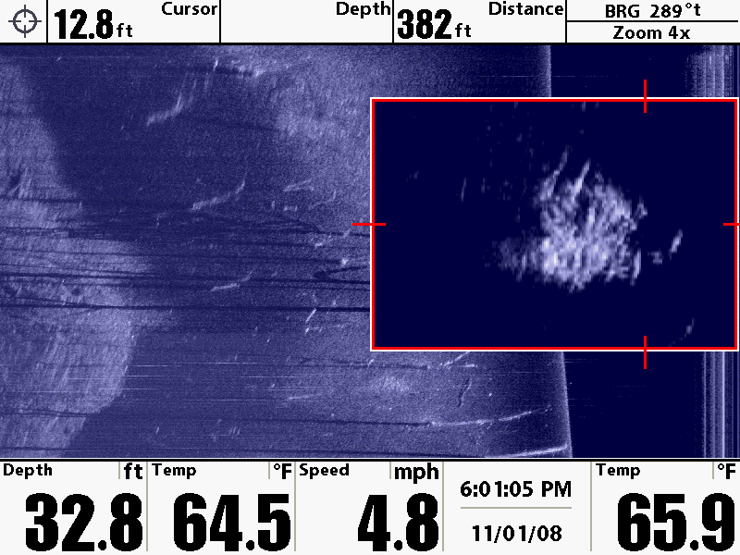
Catching Fish with Side Imaging

Slide 17
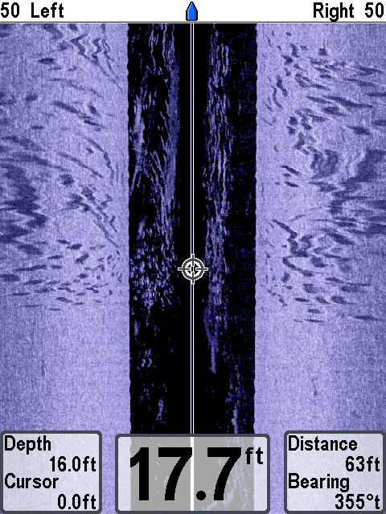
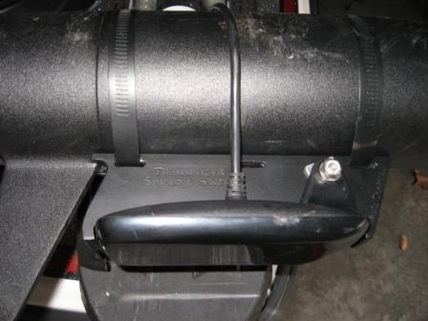
Catching Fish with Side Imaging
Trolling Motor Mounted Side Imaging

Slide 18
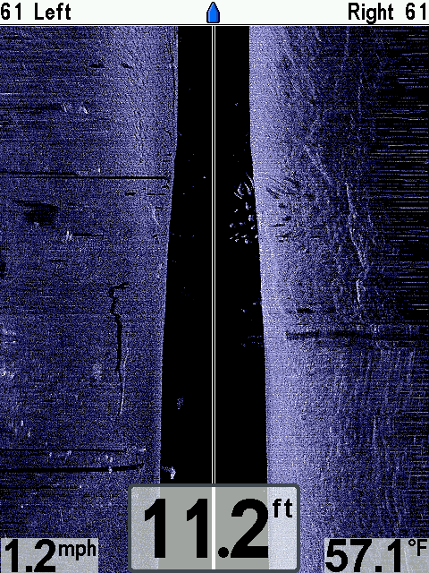
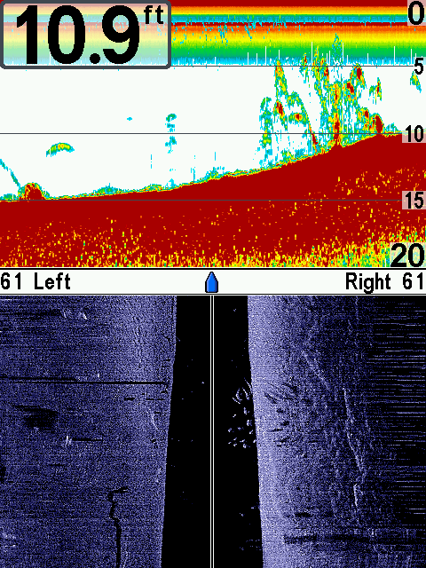
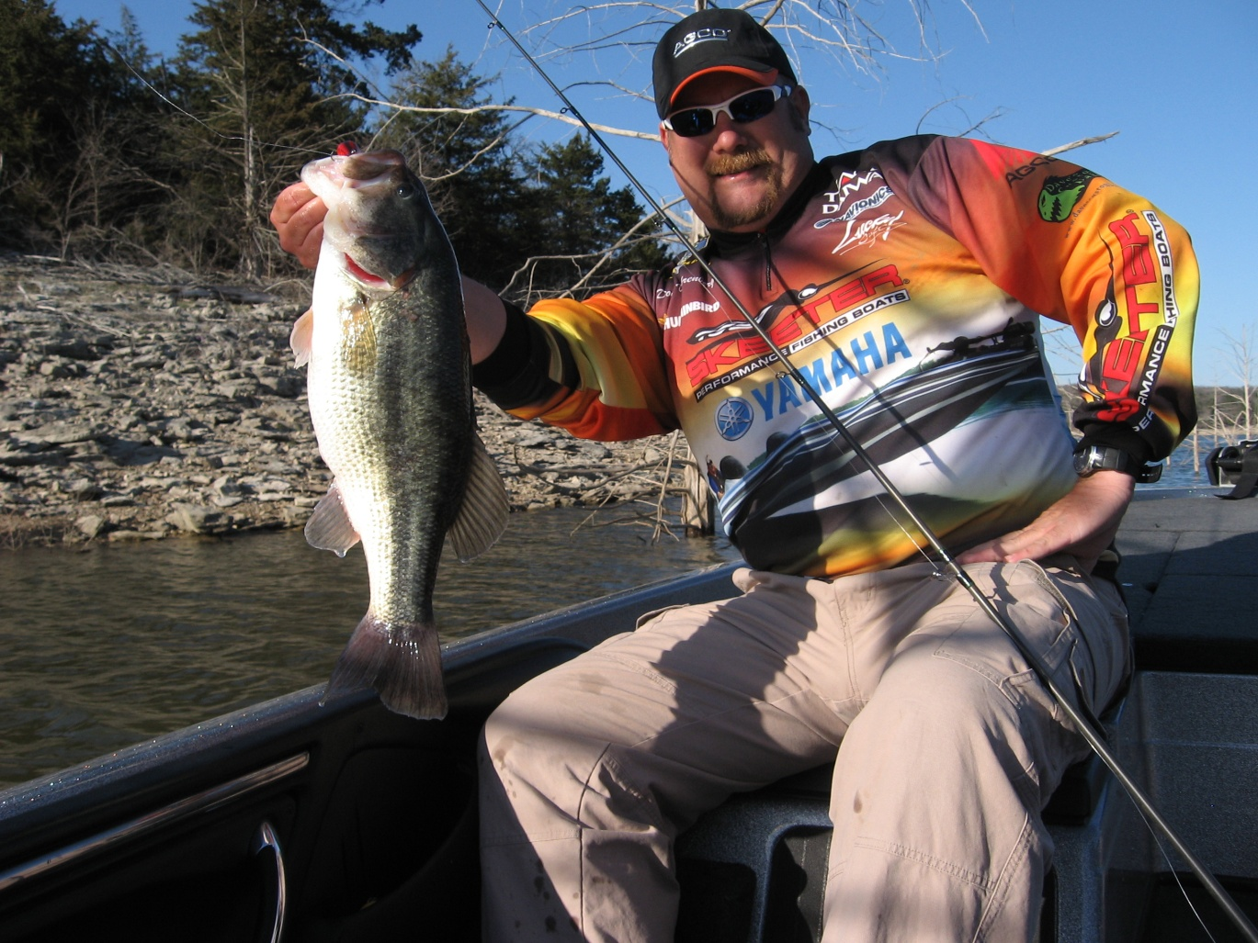
Catching Fish with Side Imaging

Slide 19
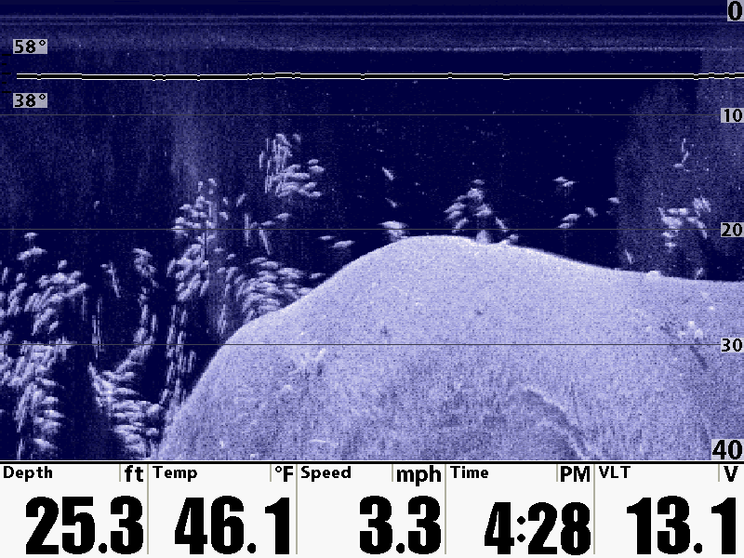
Catching Fish with Down Imaging

Slide 20
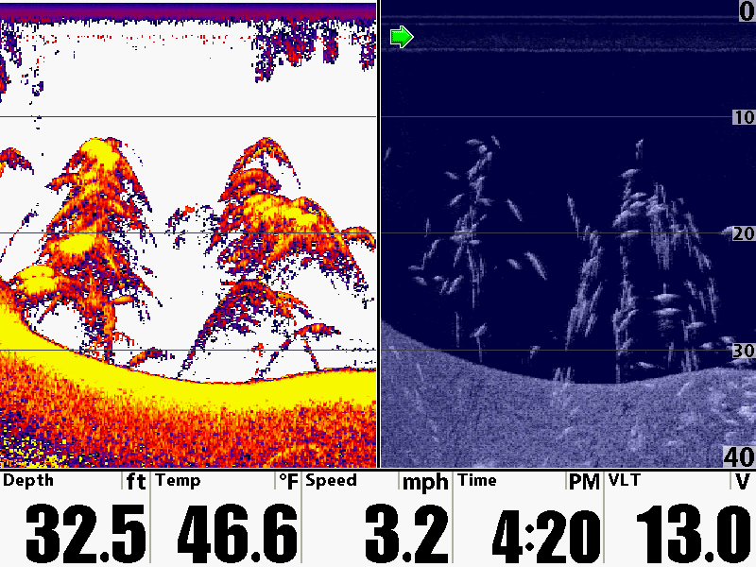
Catching Fish with Down Imaging

Slide 21
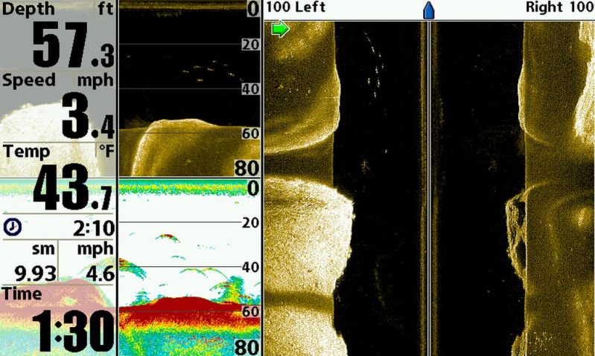
Catching Fish with Down Imaging

Slide 22
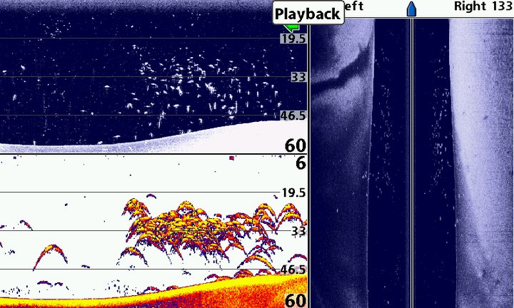
Catching Fish with Down Imaging

Slide 23
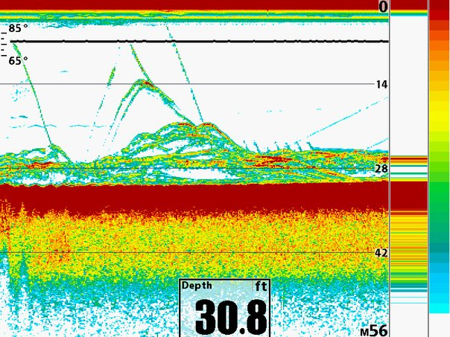
Catching Fish with 2D Sonar

Slide 24
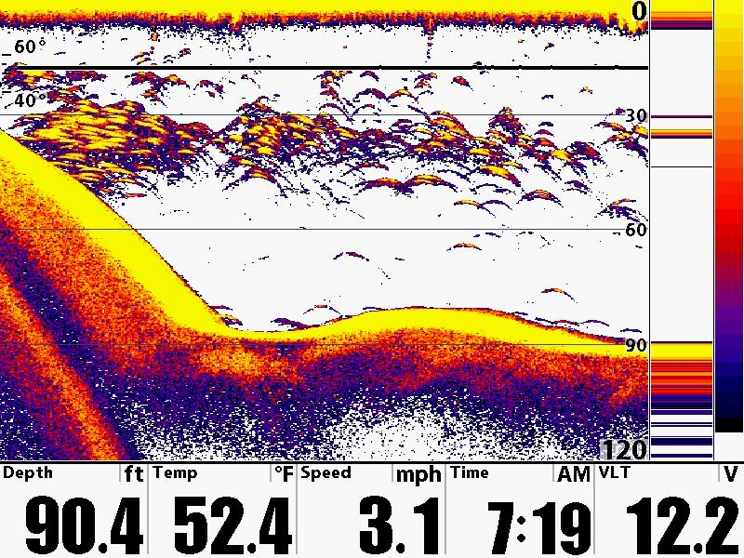
Catching Fish with 2D Sonar

Slide 25
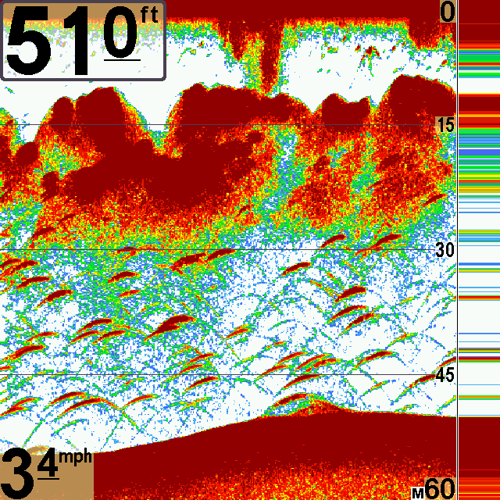
Catching Fish with 2D Sonar

Slide 26
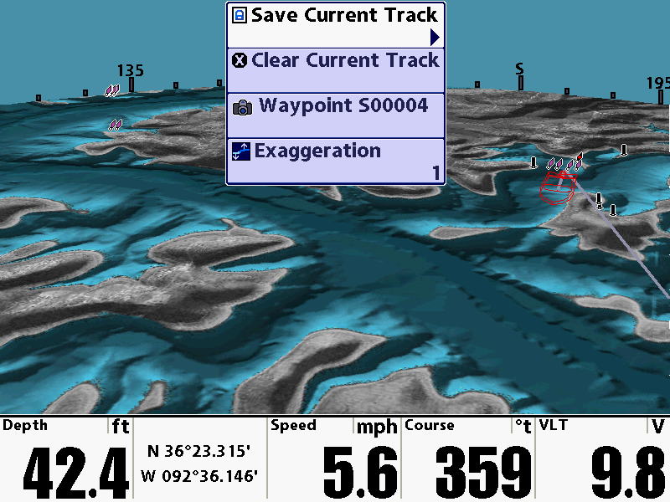
Catching Fish with GPS

Slide 27
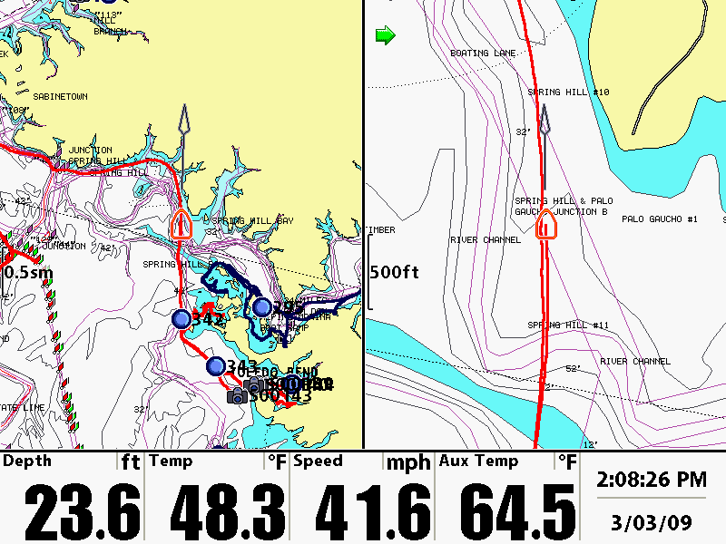
Catching Fish with GPS

Slide 28
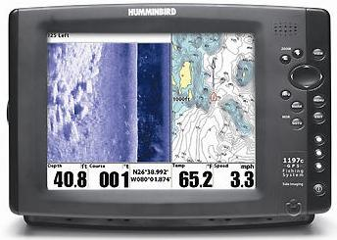
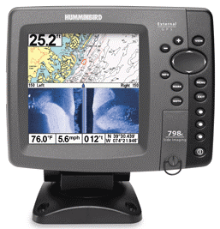
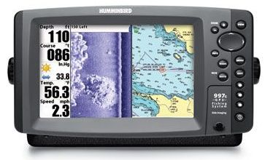
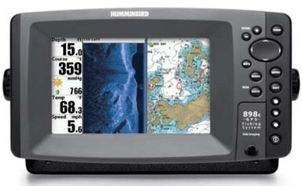
Catching Fish with…
1197c
10.4” Screen
798c
5” Screen
998c
8” Screen
898c
7” Screen

Slide 29
Catching Fish with Side Imaging
Doug Vahrenberg
Humminbird Pro-Team
Learn More Visit
Yahoo Groups – sideimaging
http://groups.yahoo.com/group/sideimaging/

Slide 30
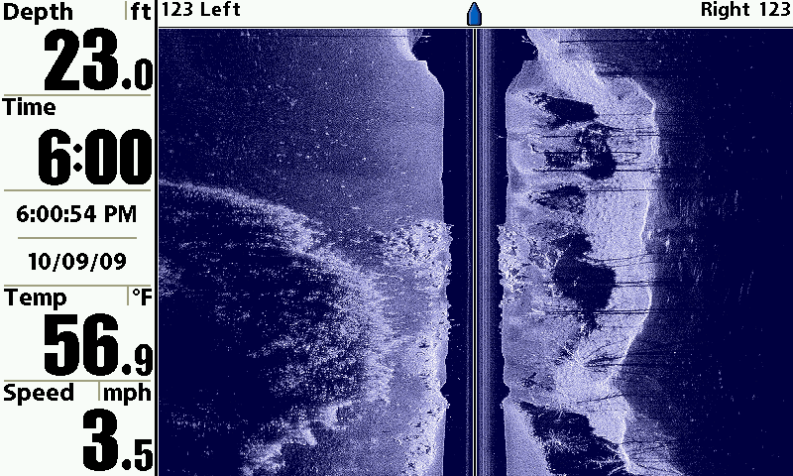
What Side Imaging Can Find

Slide 31
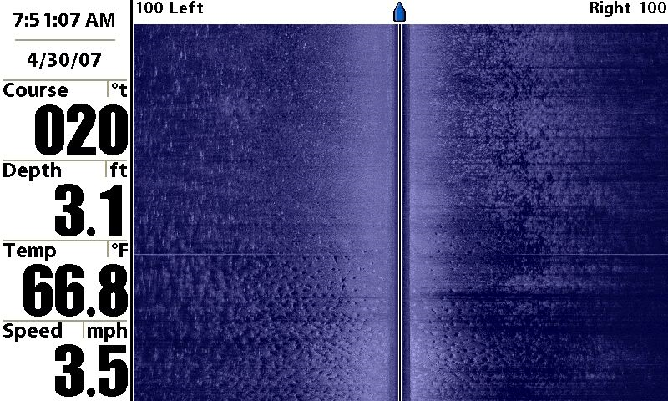
What Side Imaging Can Find

Slide 32
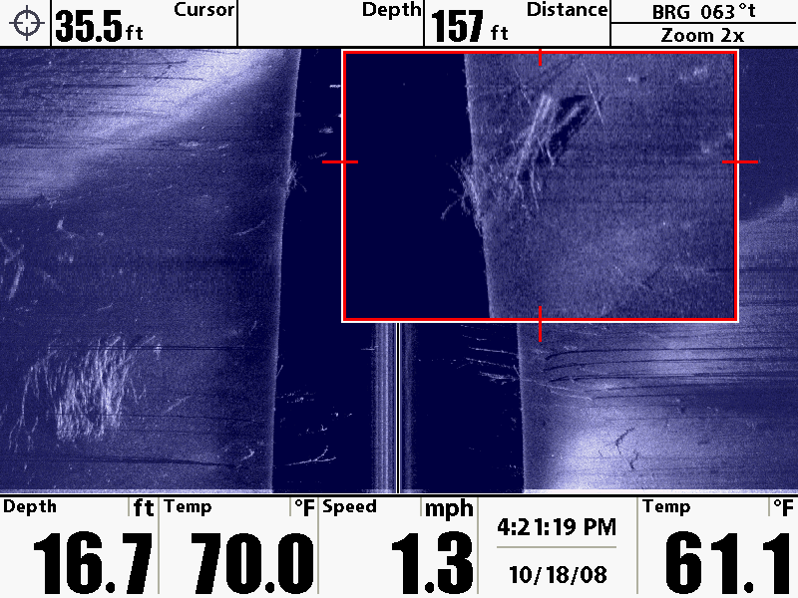
What Side Imaging Can Find

Slide 33
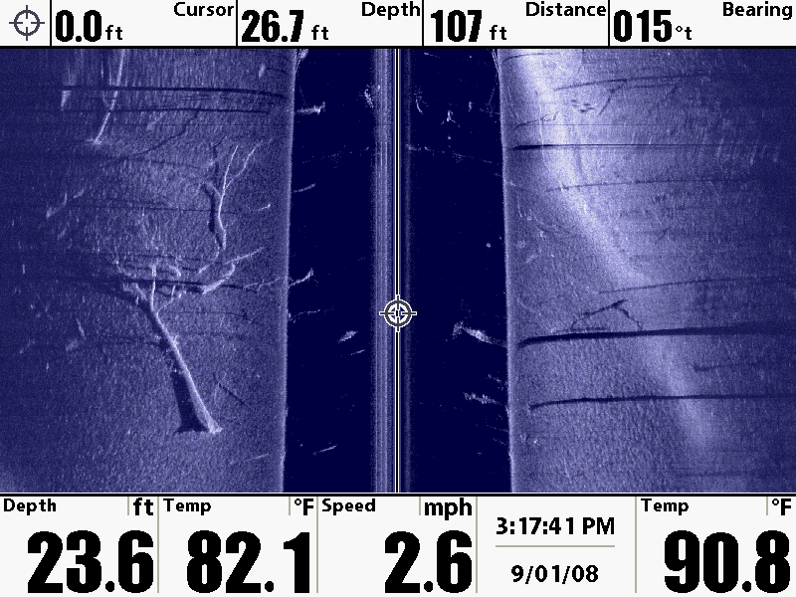
What Side Imaging Can Find

Slide 34
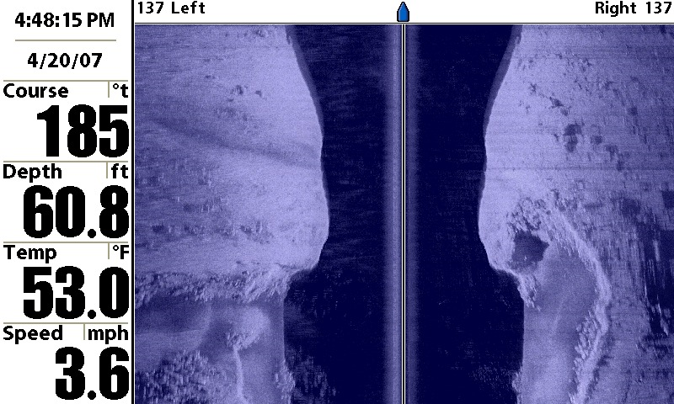
What Side Imaging Can Find

Slide 35
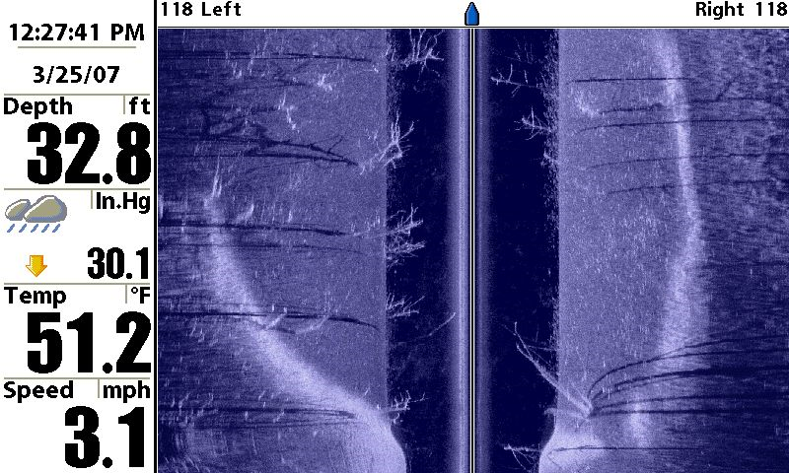
What Side Imaging Can Find

Slide 36
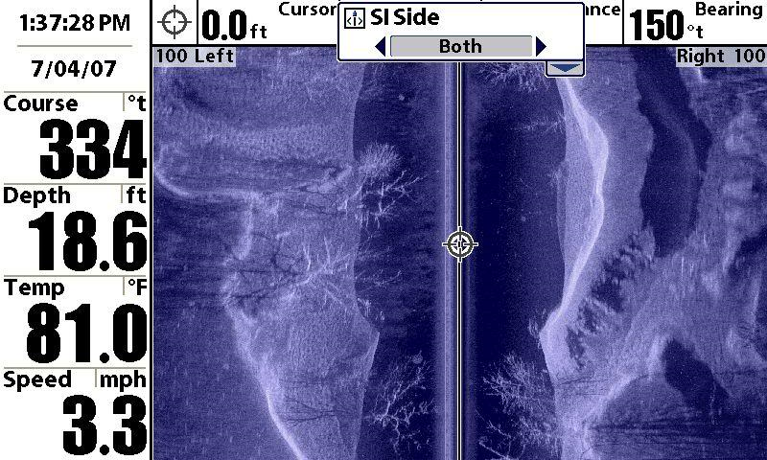
What Side Imaging Can Find

Slide 37
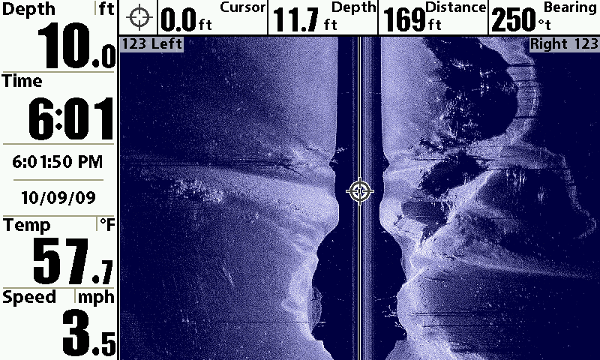
What Side Imaging Can Find

Slide 38
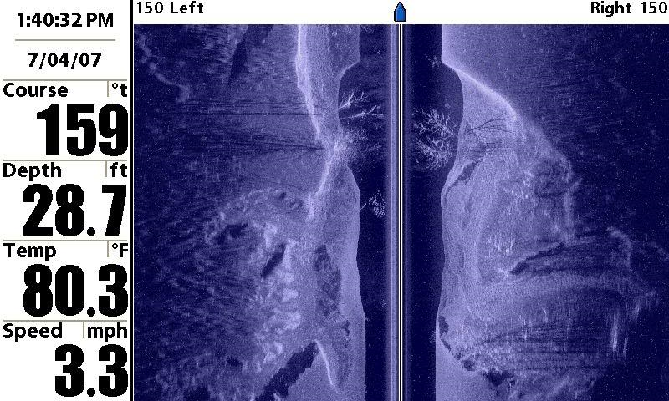
What Side Imaging Can Find

Slide 39
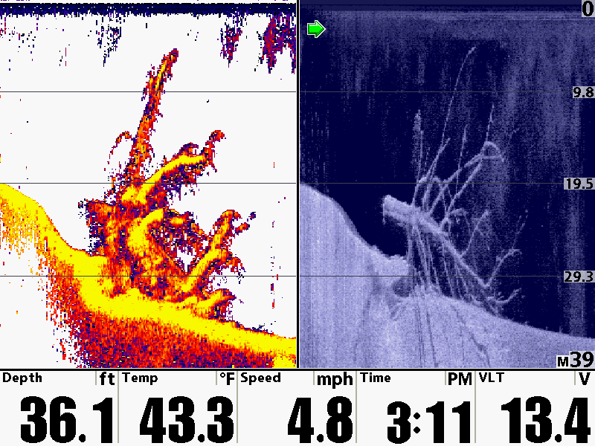
What Down Imaging Can Find

Slide 40
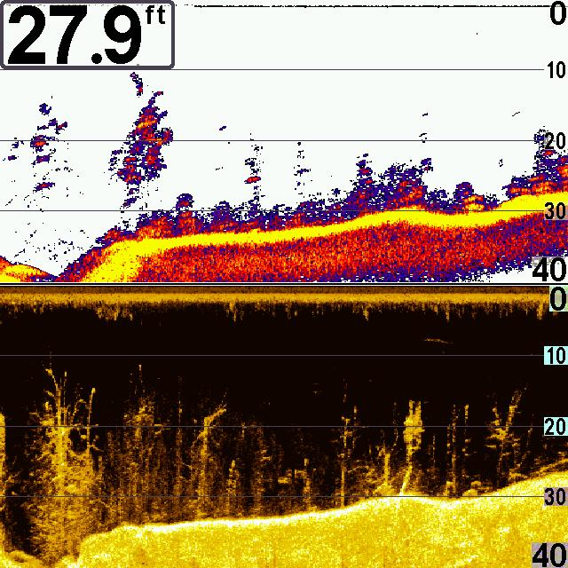
What Side Imaging Can Find

Slide 41
Catching Fish with Side Imaging
Doug Vahrenberg
Humminbird Pro-Team
Learn More Visit
Yahoo Groups – sideimaging
http://groups.yahoo.com/group/sideimaging/

