Slide 1


What’s New
Doug Vahrenberg
National Pro-Team Member

Slide 2
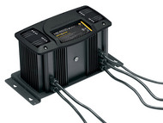
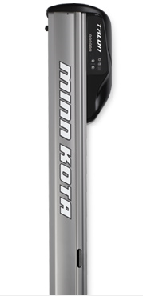
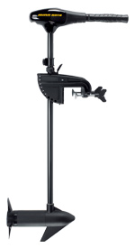
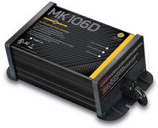
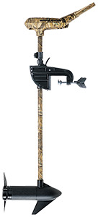
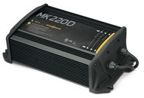
What’s New

Slide 3

What’s New
ENDURA C2
YOU CAN’T BEAT A TRUE ORIGINAL.
Available Thrust Levels
30#, 40#, 45#, 50#, 55#
Shaft Length
30", 36", 42”
12 VOLTS

Slide 4
What’s New
Camo Waterfowl Edition
ENDURA C2
YOU CAN’T BEAT A TRUE ORIGINAL.
Available Thrust Levels
44#, 55#
Shaft Length
36”
12 VOLTS

Slide 5




What’s New
ENDURA C2
YOU CAN’T BEAT A TRUE ORIGINAL.
Telescoping Handle
Power Prop
Lever Lock Bracket

Slide 6
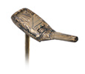
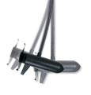

What’s New
ENDURA C2
YOU CAN’T BEAT A TRUE ORIGINAL.
Indestructible Composite Shaft
Tilt Twist Tiller
Cool, Quiet Power
Guaranteed For Life!

Slide 7


What’s New

Slide 8
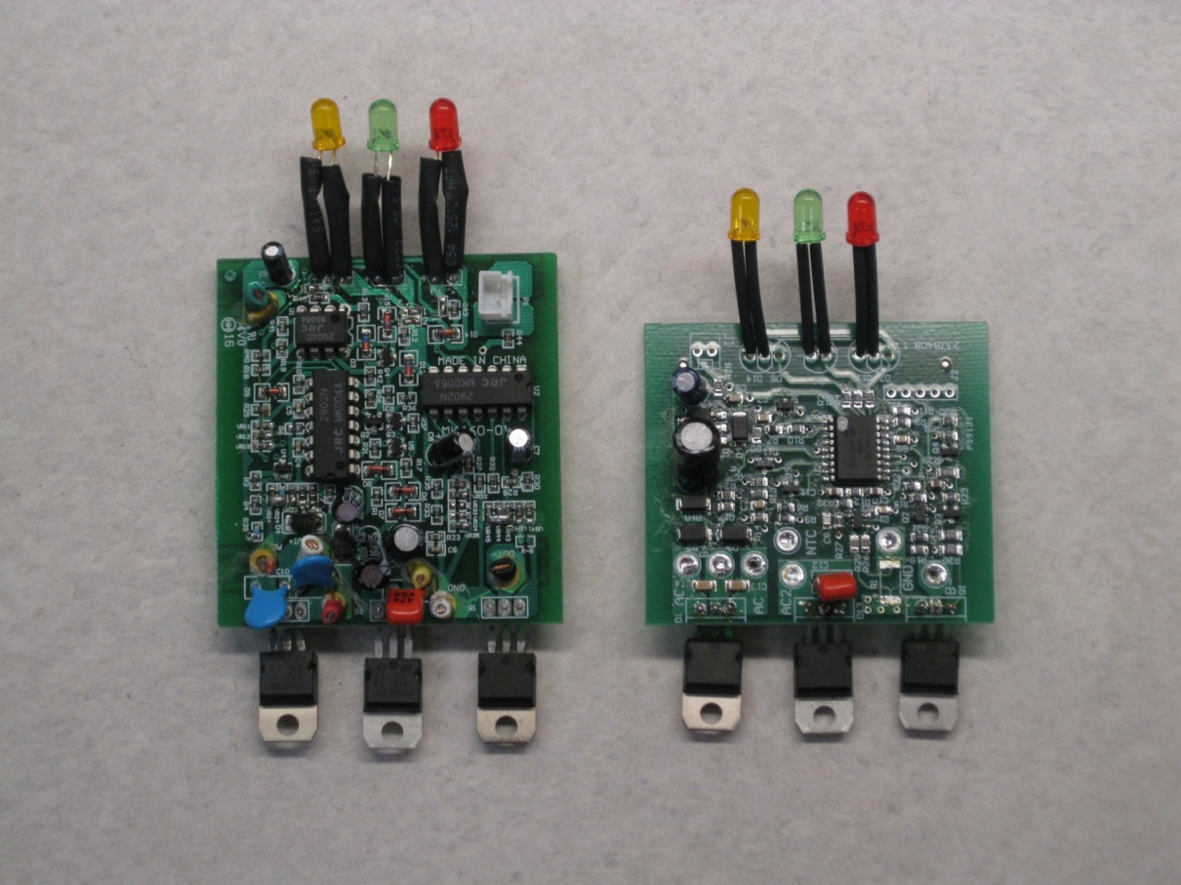
What’s New
micro-processor

Slide 9

What’s New
  Digital uses new micro-processor design
  expanded feature list and functions
    Arc Protection
    Time-out if charger doesn’t reach set voltage within 3 hours
    Time-out of Bulk Stage after 20 hours
    Time-out feature after 24 hours; turns back on if voltage drops below 12.6 Volts
    Indication of each stage of charge

Slide 10
What’s New
Microprocessor design provides software enriched features
  More repeatable set points (voltage limit and current) = improved charge curves
  Maintenance mode time-out feature (auto-off)
  Arc protection
  Enhanced status codes
    System okay
    Charge stage indication (Bulk, Absorption, or Maintenance)
    Full charge
    Maintenance mode status
    Multiple specific error indications – low battery voltage, high output lead temperature, etc.

Slide 11
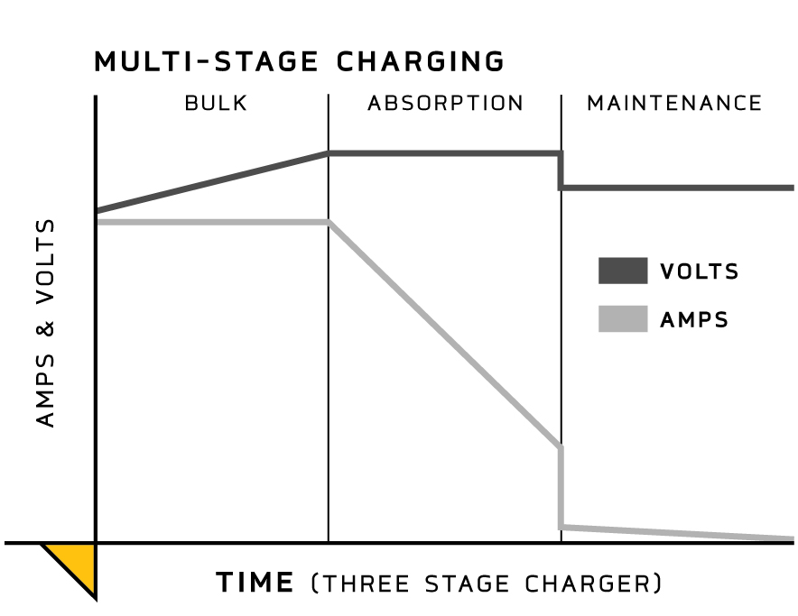


What’s New
Automatic 3-stage charging
Bulk – high amps at low voltage until battery reaches ~75% charge
Absorption – at ~75% charge, current tapers down until the battery voltage reaches 14.8V (full charge)
Maintenance (or Float) – when the battery voltage reaches full charge, charger output is dropped to 13.2V-13.5V (.1A-.3A). After 24 hours, the charger automatically turns off and automatically turns on when the battery voltage drops below 12.6 volts

Slide 12

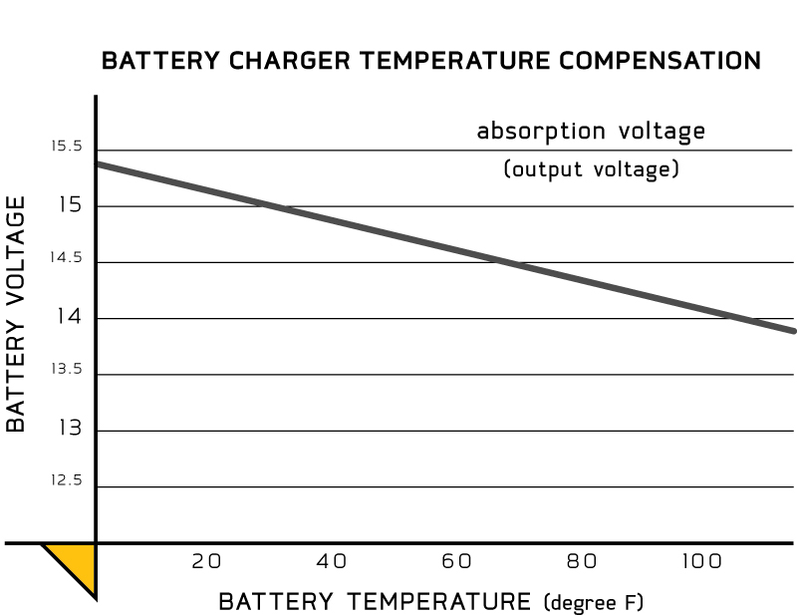

What’s New
Automatic Temperature Compensation
  Senses temperature and adjusts output voltage
  Protects batteries from overcharging at high temperatures
  Maintains gassing threshold for a full charge
Gassing Threshold
  Voltage level at which electrolyte begins moving within the battery
  This threshold must be reached in order to fully charge a battery
Effect of Temperature
  Gassing threshold is higher at lower temps, lower at higher temps
  Too much voltage at high temperatures can “boil” and destroy a battery

Slide 13
What’s New
Not all chargers are created equal!
3 Stage Charging
Temperature Compensated
Digitally Controlled Processor
3 Year Warranty
Enhanced Status Codes
Designed to Compliment Boat Accessories

Slide 14

What’s New
MODEL | BANKS | AMP/BANK | TOTAL AMPS
MK106D | 1 | 6 | 6
MK110D | 1 | 10 | 10
MK210D | 2 | 5 | 10
MK220D | 2 | 10 | 20
MK230D | 2 | 15 | 30
MK315D | 3 | 5 | 15
MK330D | 3 | 10 | 30
MK330D | 3 | 15 | 45
MK440D | 4 | 10 | 40
MK460D | 4 | 15 | 60

Slide 15
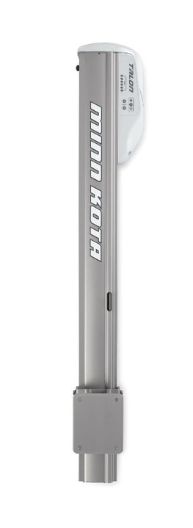
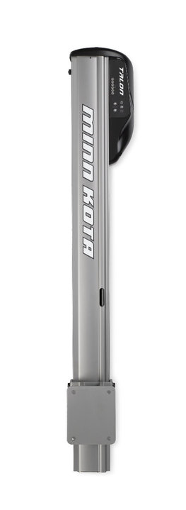



What’s New

Slide 16
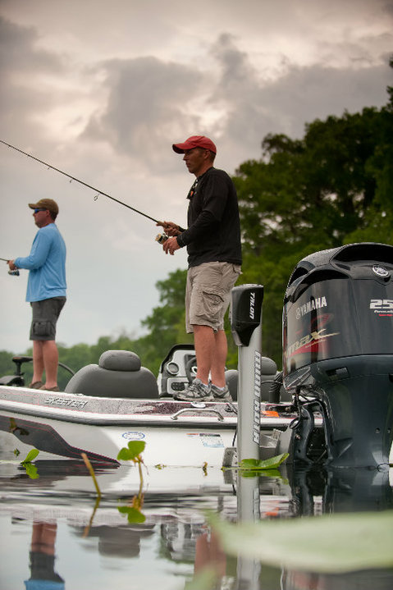
What’s New
Shallow-Water Anchors
2 Lengths: 6’4” and 8’4”
2 Colors White or Black

Slide 17
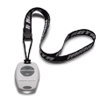
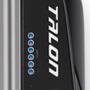
What’s New
Standard Features
Self Contained System
All Electric System
2 Remotes Standard Equipment
Easy to Transfer or Remove
LED Depth Indicator

Slide 18
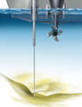

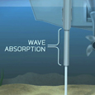
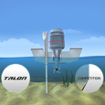
What’s New
Shallow Water Anchors
Fast Deployment
2 Stage Deployment
Auto Drive
Built-In Wave Absorption
Auto Up – Auto Down

Slide 19
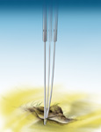
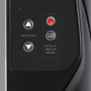
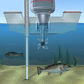
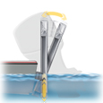
What’s New
Shallow Water Anchors
Rough Water Mode
Simple Quiet Design
Versatile Adjustments
Lifetime Spike Warranty
2 Year Warranty

Slide 20
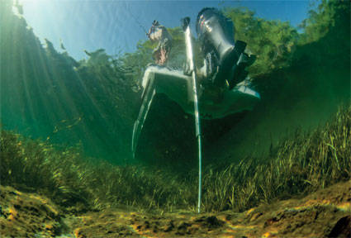
What’s New
ICAST 2010
NEW PRODUCT
INNOVATION AWARD

Slide 21
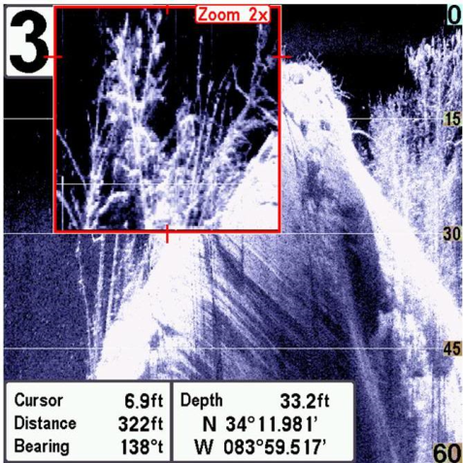
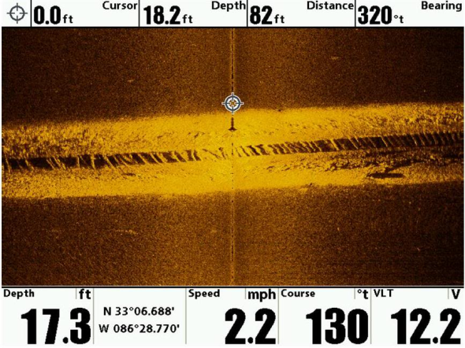
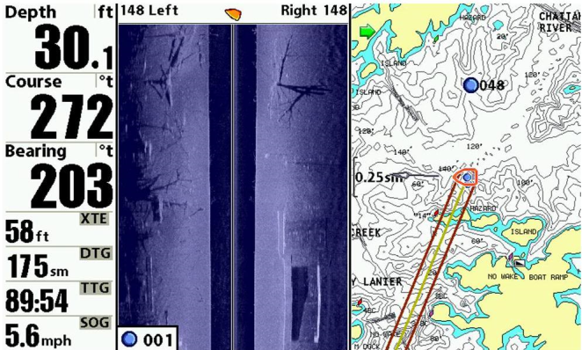
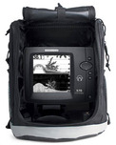
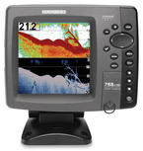
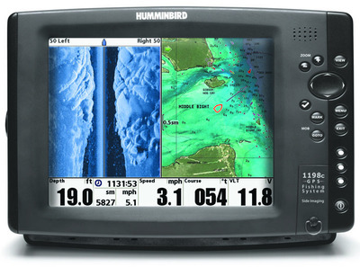
What’s New

Slide 22

What’s New

Slide 23
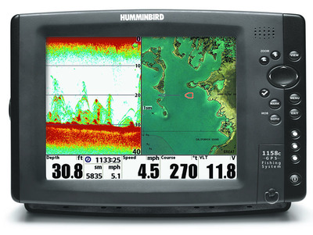
What’s New
1158c
Faster Processor
LED Backlit LCD
Ethernet Ready
Switchfire 2D
GPS Mapping
1198c
Faster Processor
LED Backlit LCD
Ethernet Ready
2D, SI, DI
GPS Mapping

Slide 24

What’s New

Slide 25

What’s New
788ci HD DI
Switchfire 2D Sonar
Down Imaging
GPS Mapping
640V x 640H Pixels
4000W PTP

Slide 26

What’s New

Slide 27
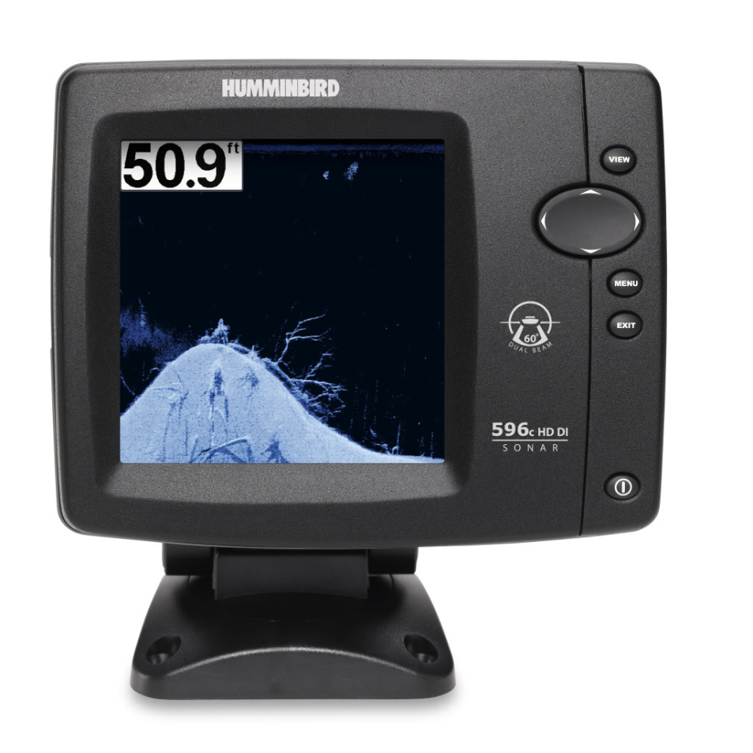
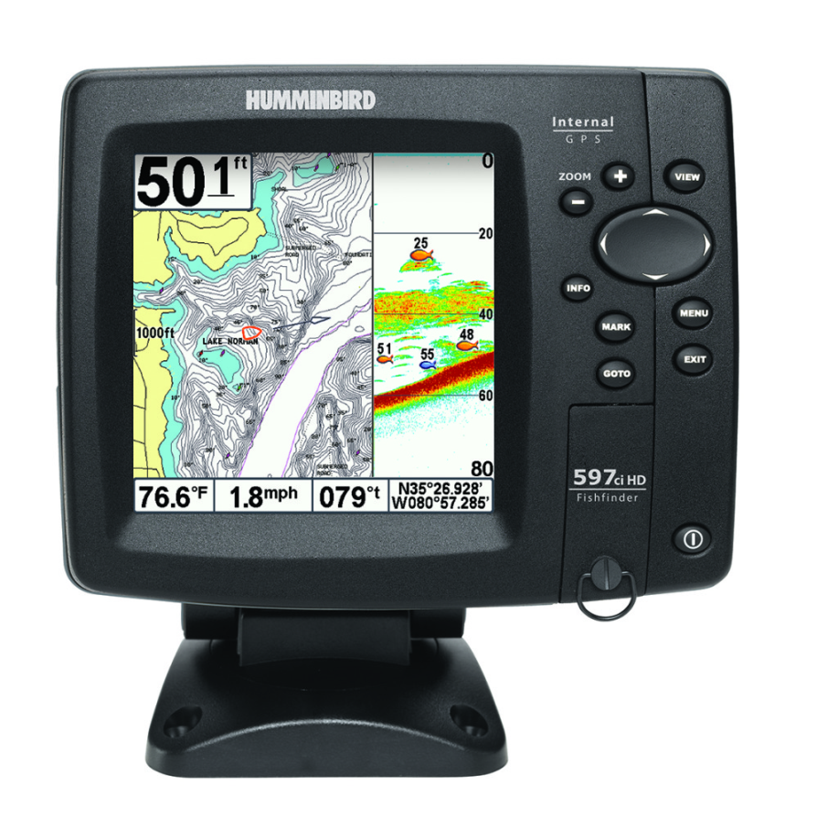
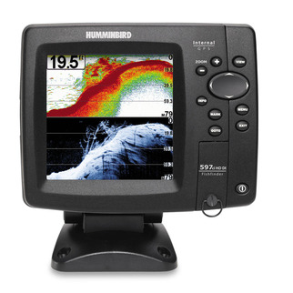
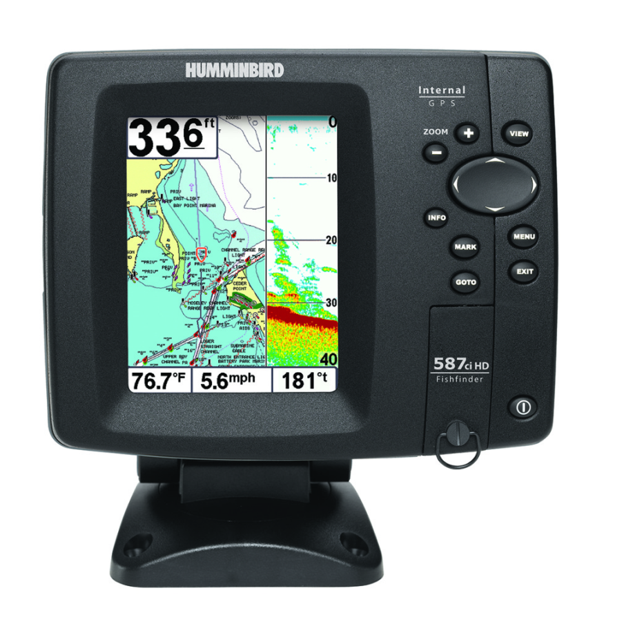
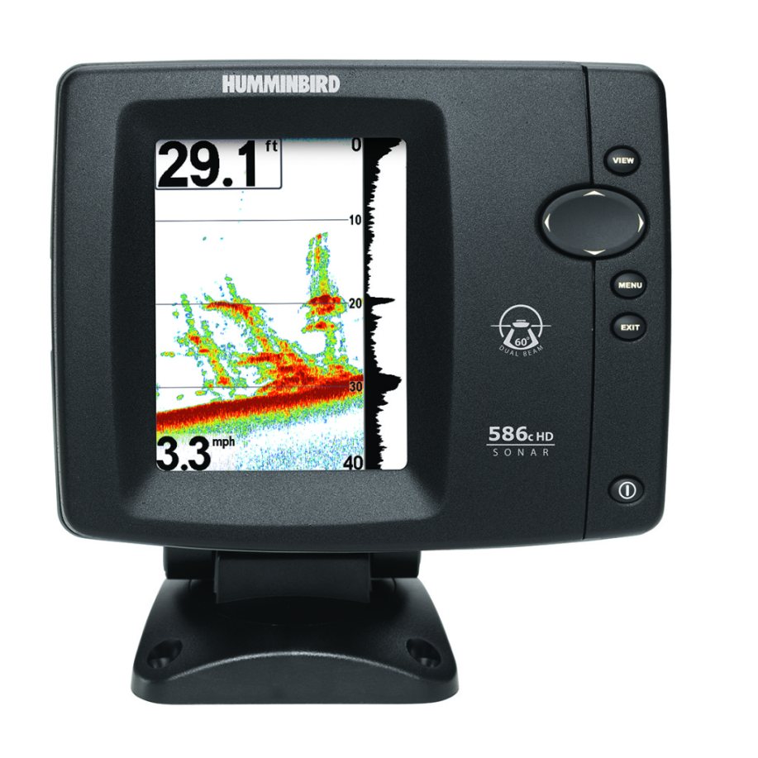
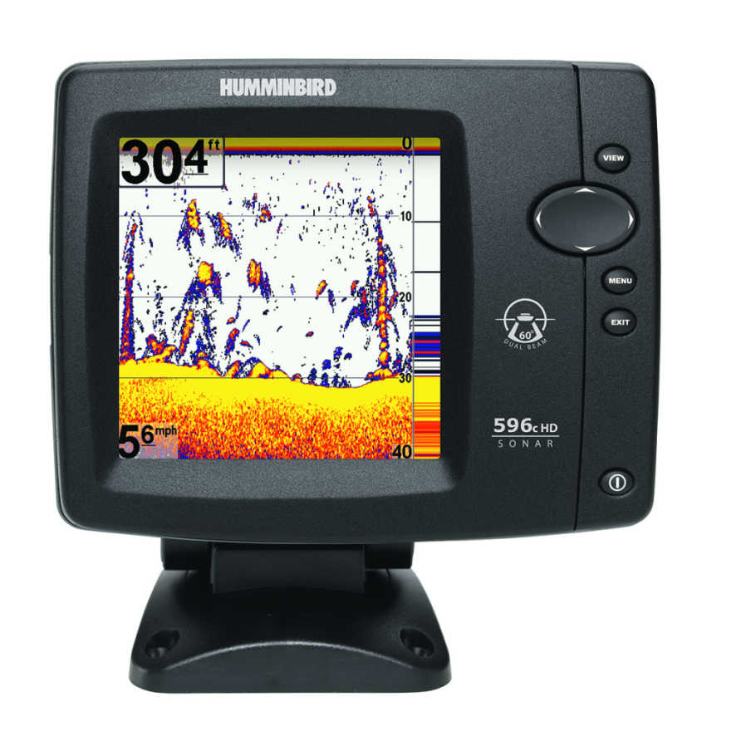
What’s New
597ci HD DI
Switchfire 2D Sonar
Down Imaging
GPS Mapping
640V x 640H Pixels
4000W PTP
587ci HD
Switchfire 2D Sonar
Dual Beam Plus
GPS Mapping
640V x 480H Pixels
2400W PTP
597ci HD
Switchfire 2D Sonar
Dual Beam Plus
GPS Mapping
640V x 640H Pixels
4000W PTP
596c HD DI
Switchfire 2D Sonar
Down Imaging
640V x 640H Pixels
4000W PTP
596c HD
Switchfire 2D Sonar
Dual Beam Plus
640V x 640H Pixels
4000W PTP
586c HD
Switchfire 2D Sonar
Dual Beam Plus
640V x 480H Pixels
2400W PTP

Slide 28
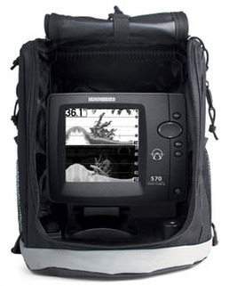
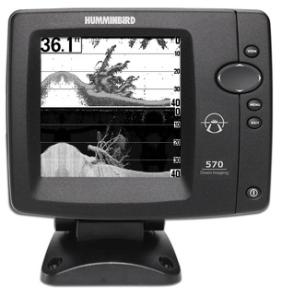
What’s New
570 DI
Switchfire 2D Sonar
Down Imaging
640V x 320H Pixels
2400W PTP
Portable Model

Slide 29
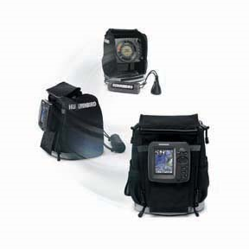

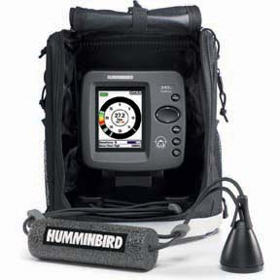
What’s New
ICE SERIES
ICE 385ci
ICE 345ci
ICE 55/385ci

Slide 30
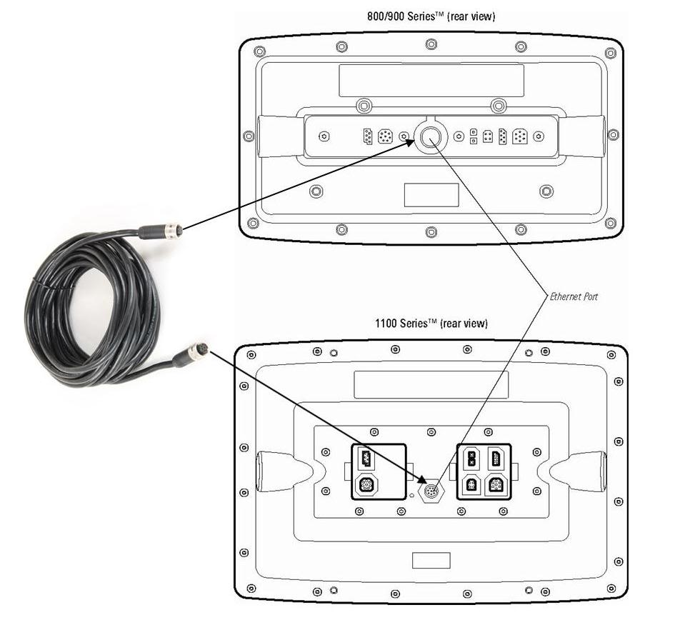

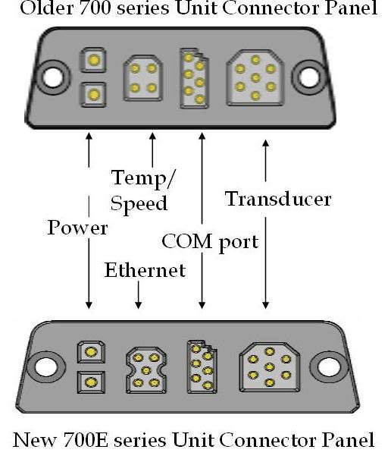
What’s New
ETHERNET

Slide 31
What’s New
ETHERNET
Allows Single Cable Networking
Share Transducer Data
Share GPS Receiver
Share Temperature Sensor
Fast Baud Rate of sharing

Slide 32
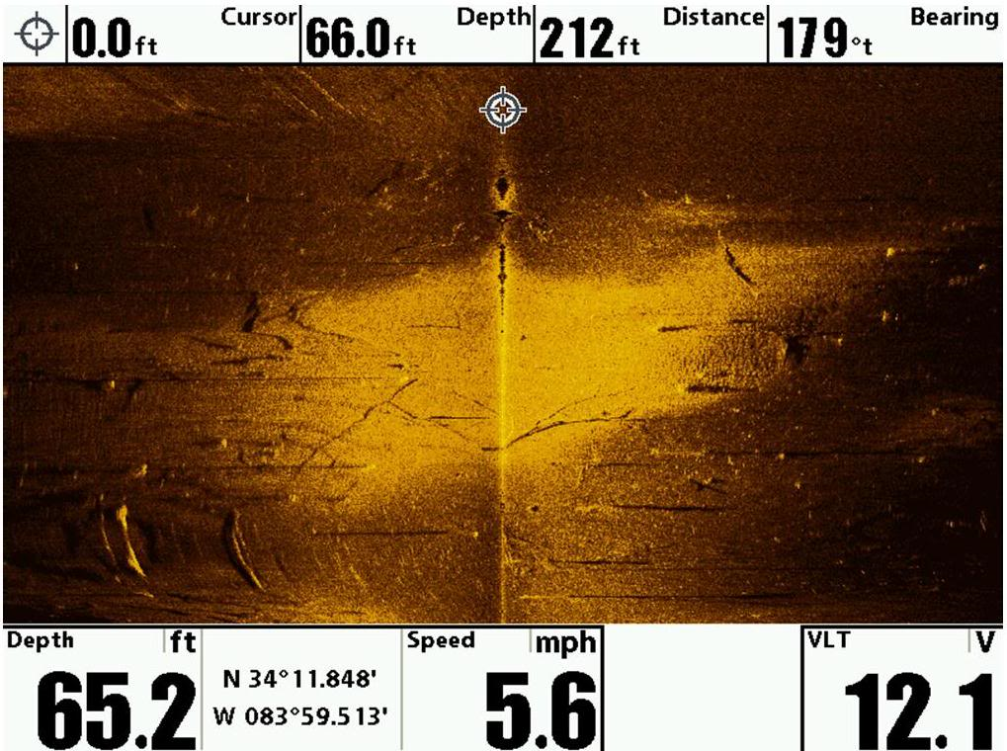

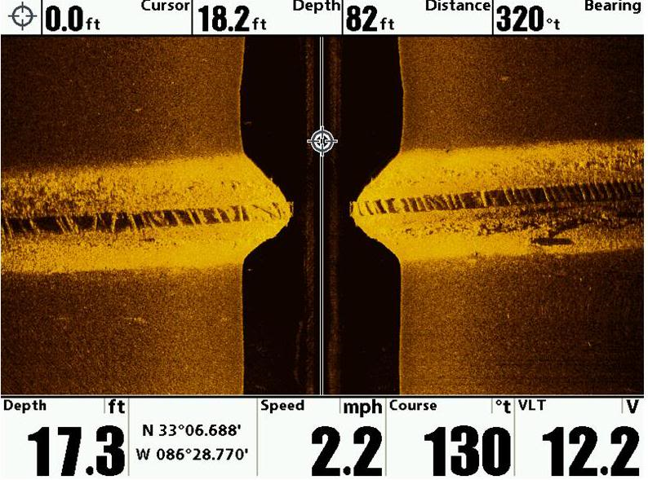
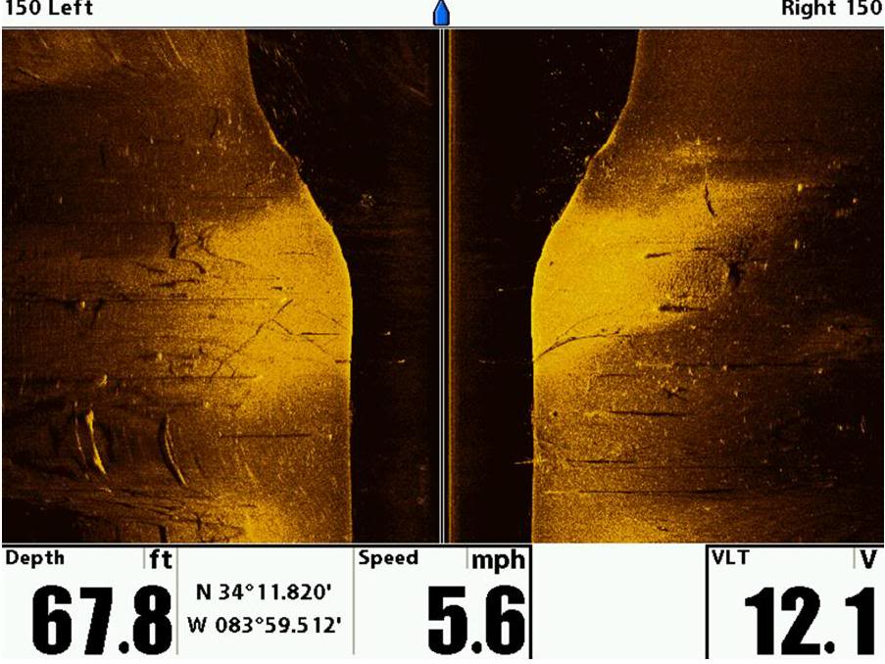
What’s New
Contour
Mode

Slide 33
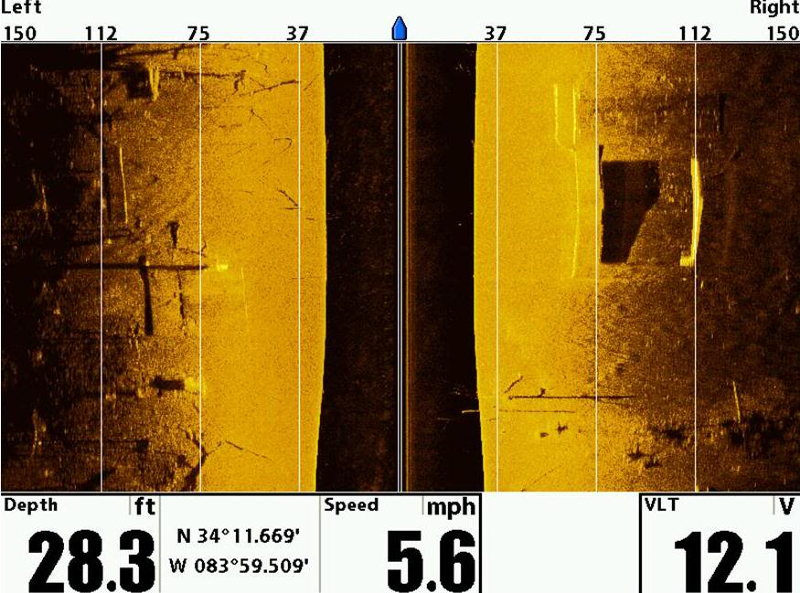
What’s New
Side Imaging
Range
Lines

Slide 34

What’s New
Side Imaging Navigation

Slide 35

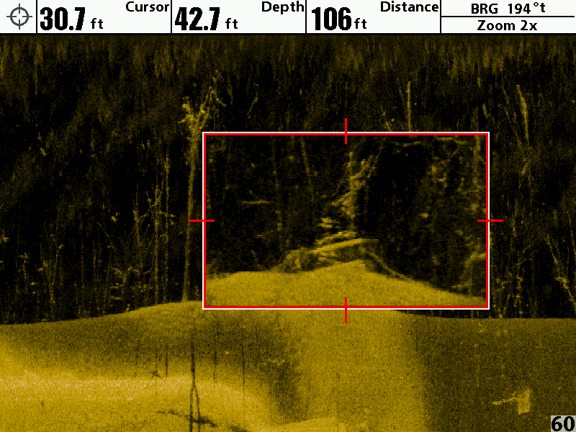
What’s New
Down
Imaging
Zoom

Slide 36
What’s New
Software Updates
Always FREE Downloads
From Humminbird.com

Slide 37






What’s New
Training Opportunities
Special Phone Support
Product Announcements
Warranty Extension
Email Notifcations
www.humminbirdselect.com
800, 900, 1100 Series

Slide 38
What’s New
THANK YOU!!!
Doug Vahrenberg
National Pro-Team Member

